Slide 1
Produce bio-composite materials from wastewater
Xuerui Song
University of Delaware, Summer Fellows Program 2018

Slide 2
About This project
Work under Professor Daniel Cha
Department: Civil & Environmental Engineering
Project leader: Xiangmin Liang
Objective (from Liang’s report):
To evaluate the potential for using both “filamentous” wastewater microorganisms (as reinforcement) and polyhydroxyalkanoates (PHA)-accumulating wastewater microorganisms as biorenewable matrix for composites
To identify filamentous bacteria that have favorable properties for using as a reinforcement in a biocomposite

Slide 3
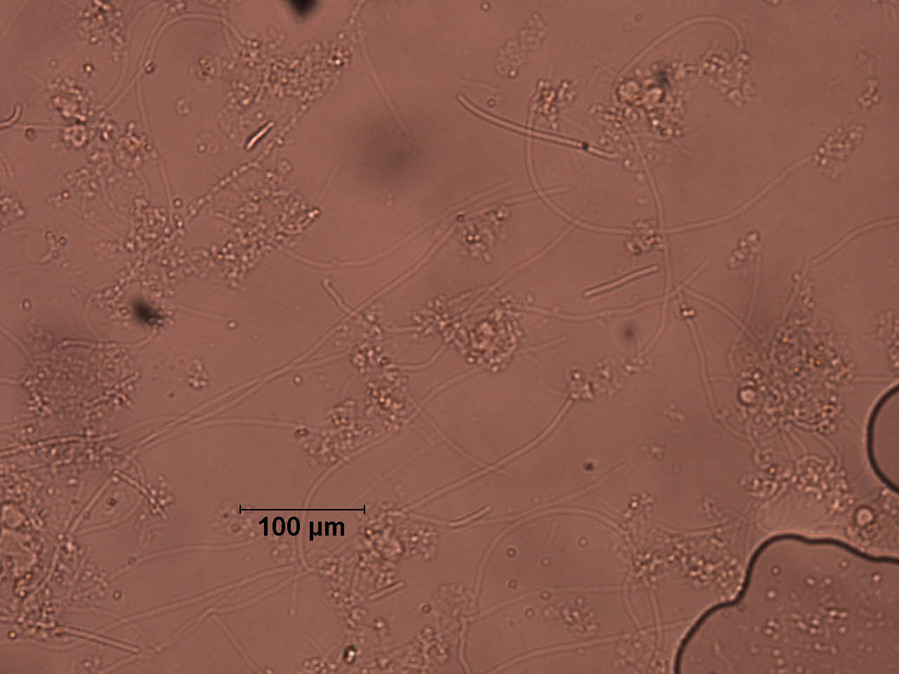
filamentous bacteria
filamentous bacteria are components of activated sludge biomass which form the important part of floc formation when they connect to each other and cause the removal of sediment from the fluid.
This image exhibits what filamentous bacteria look like under 20x optical microscope

Slide 4
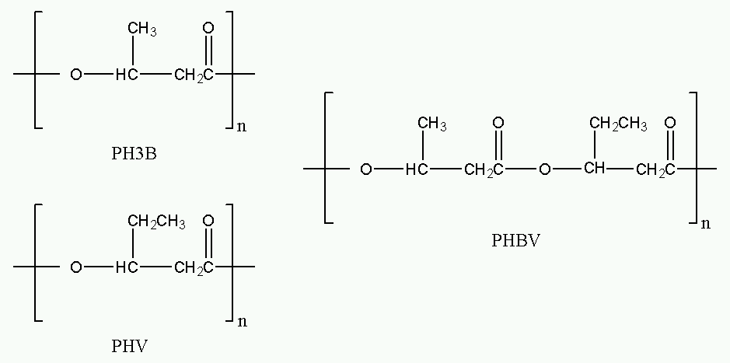
PHA
Polyhydroxyalkanoates or PHAs are made up of a group of natural biodegradable polyesters that are synthesized by numerous microorganisms.
Two common types of PHA are Polyhydroxybutyrate (PHB) and polyhydroxyvalerate (PHV)
Biodegradable, environmental friendly and biocompatible thermoplastics
About 300 kinds of bacteria accumulate PHA as storage products
PHA Structure
Source: https://en.wikipedia.org

Slide 5
Three types of reactors in the lab
1. Membrane Bioreactor (MBR)
One form of the activated sludge process
Membrane as a physical barrier for separation
Bacteria are selected based on long main cell residence time and low COD from wastewater treatment plant
2. Sequencing Batch Reactor (SBR)
One form of the activated sludge process
Phase separation used to separate the mixed liquor from the wastewater
Bacteria are selected based on shorter main cell residence time and higher COD from wastewater treatment plant
3. Fed Batch Reactor (FBR)
Used in fermentation
Cyclical feeds and extractions
Remain bacteria (inoculation from SBR system) in the reactor

Slide 6
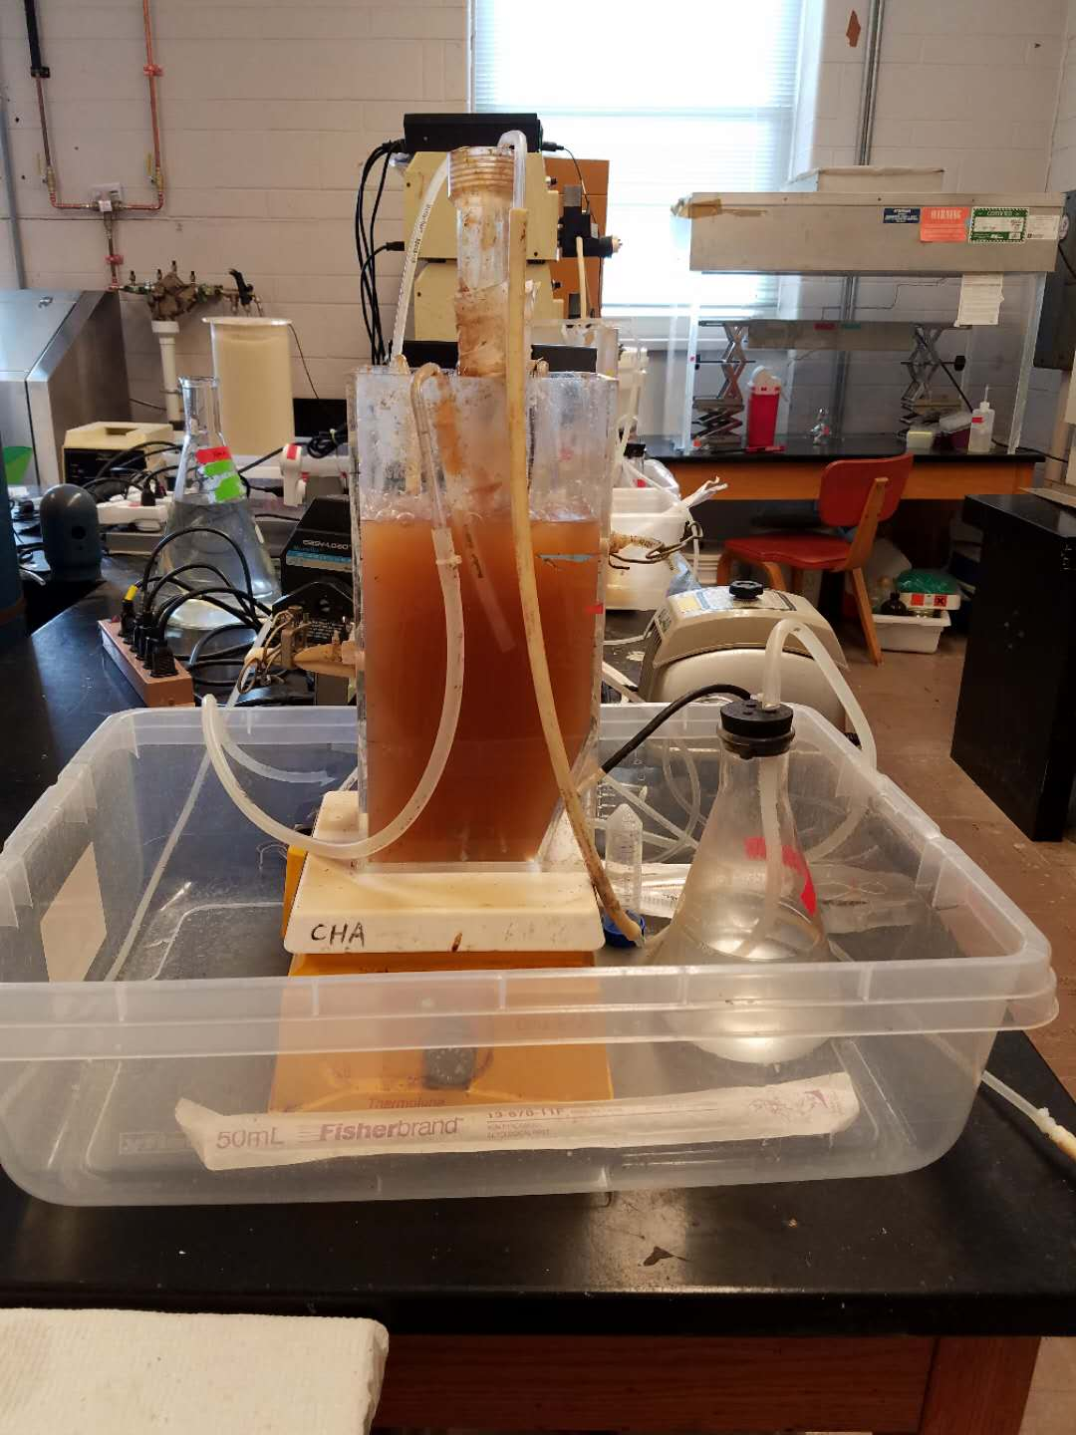
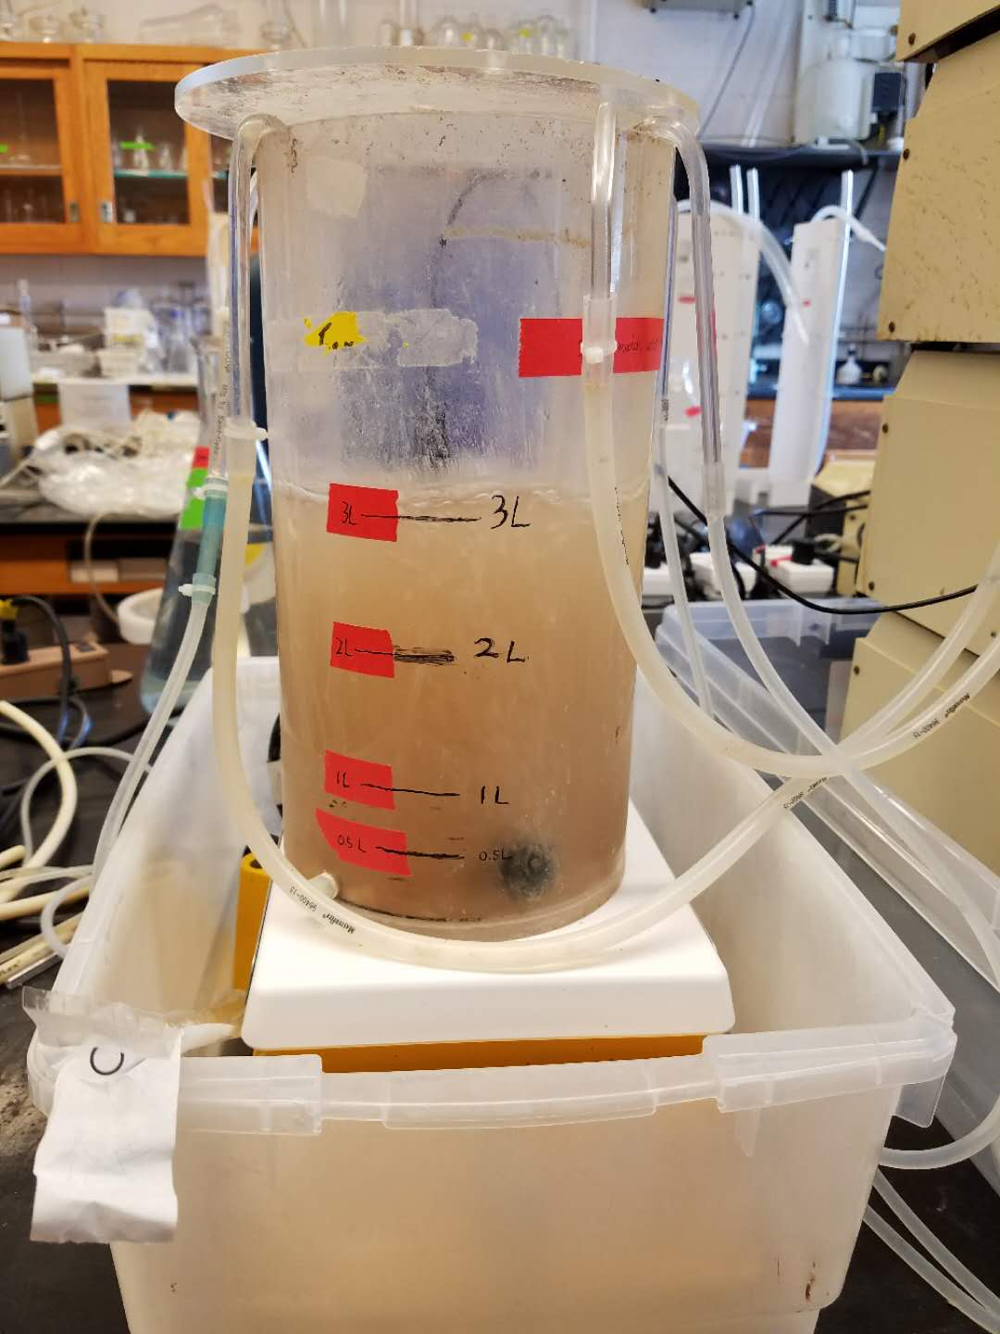
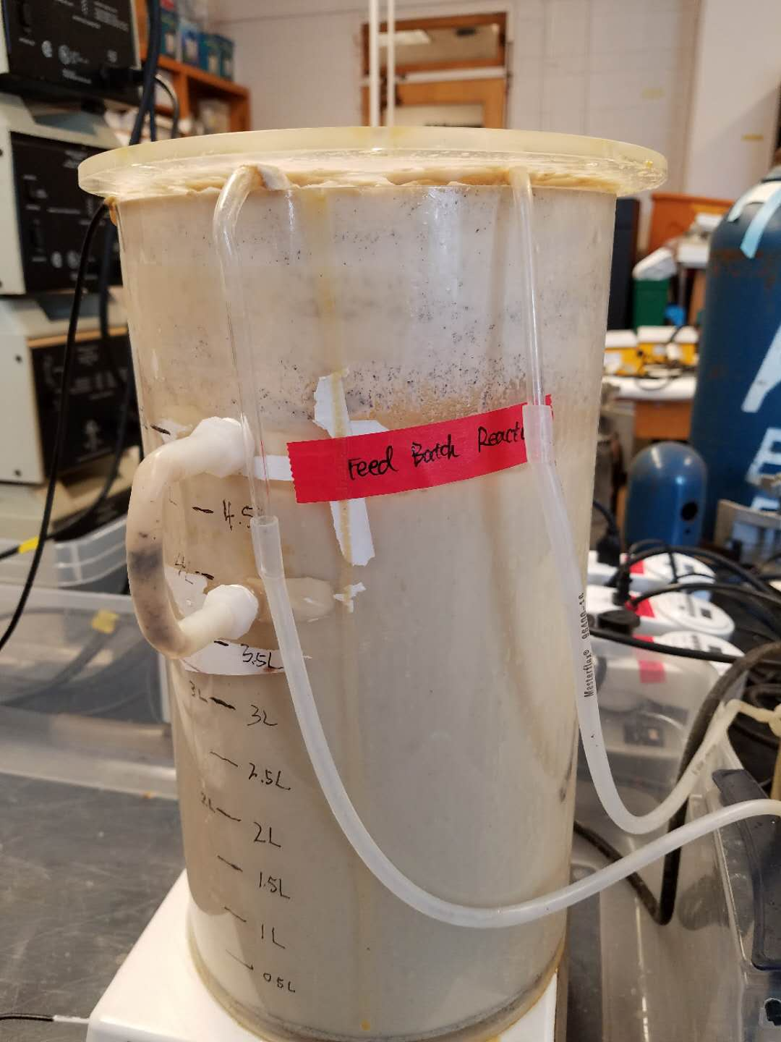
Sequencing Batch Reactor
Fed Batch Reactor
Membrane Bioreactor

Slide 7
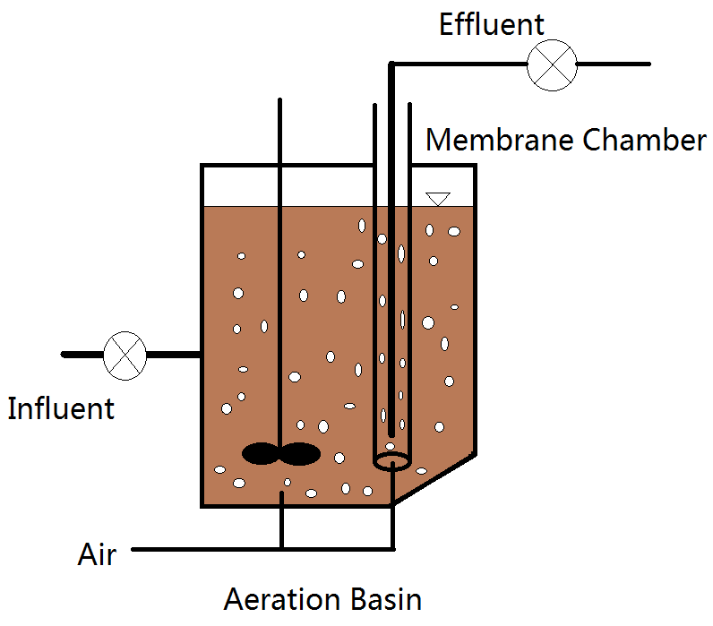
Structure of MBR

Slide 8




timeline of SBR
12:30 pm -1:30 pm: settling, turn off the pH controller, air pump, stirring plate and decant pump
1:30 pm -2:00 pm: decant
2:00 pm – 2:10 pm: refill reactor to 3L by using fill pump from the media container
2:10 pm – 12:30 pm (next day): react

Slide 9
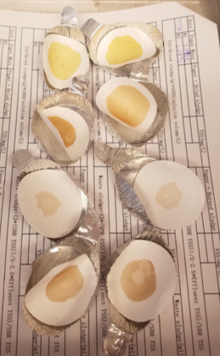
My Work
Make sure there is enough media for each system (SBR consumes 2.5 L media per day, MBR consumes 6 L media per day)
Do Total Suspended Solids (TSS) test for SBR effluent, SBR solution, MBR solution and FBR solution every day to calculate the waste
Do Volatile Suspended Solids test for SBR effluent, SBR solution, MBR effluent, MBR solution and FBR solution every Tuesday
Measure anion concentration in SBR and MBR effluent every Wednesday
Measure Total Organic Carbon in FBR every day
Samples for TSS test

Slide 10
Current stage – PHB Extraction
Successfully culture filamentous bacteria in reactors, FBR has the most
Polyhydroxybutyrate (PHB), a common type of PHA, is a biodegradable plastic.
Filamentous bacteria is one kind of PHB accumulated bacteria and produce PHB when they are hungry
Glucose is the feed for FBR
Main goal is to test the practicability of the extraction
Result:
We did at least 5 times of PHB extraction, but only got final product twice

Slide 11
PHB Extraction procedure
1. Take 25 ml mixed liquor into tube and centrifuge
2. Waste supernatant and add 25ml DI water, mix through
3. Add 0.2 g of sodium dodecyl sulfate and 0.18 g EDTA in to the tube
4. Autoclave the mixed liquor under 121 ºC for 30 minutes
5. After autoclaving, centrifuge
6. Waste supernatant and add 25 ml of DI water into centrifugation tube and mix thoroughly
7. Centrifuge
8. Waste supernatant and add 1 ml of DI water into centrifugation tube and mix thoroughly
9. Add 10 ml of acetone into centrifugation tube and mix thoroughly
10. The mixed liquor is filtered in a Buchner funnel and wash with DI water for 3 times then rinse with acetone then let it dry
11. The filter paper is put into a 150 ml glass baker, add 0.02 g of celite filtering agent and 30 ml of chloroform, then boil to boiling for 1 minute
12. The entire solution is filtered in a Buchner funnel
13. Repeat step 11 and 12 twice, collect all the filtrate
14. All the filtrate is boil to boiling until total volume is about 30 ml and allowed to cool for 5 minutes
15. Add 15 ml of methanol into cooled filtrate and is filtered in a Buchner funnel then rinse with acetone then allow to dry
16. Peel the PHB from filter paper

Slide 12
Future work
Short term: adjust the frequency and amount of glucose that add in to FBR
Long term:
PHA will be generated and recovered from lab-scale reactors that have been designed to enrich for PHA-rich biomass
Filamentous bacteria isolated from mixed microbial consortia will be individually tested for strength and toughness for the selection of ideal reinforcement agents.
Biocomposites will be manufactured by combining the biopolymer and reinforcing filaments.
Polymers and composites will be tested to determine their thermal and mechanical properties, and morphology.

Slide 13
Acknowledgement
Dr. Daniel Cha
Xiangmin Liang
Inyoung Kim
Dr. Yu-Han Yu

