Slide 1
Transtibial Amputee Human Motion Analysis
Christian S. Poindexter, Dr. Elisa S. Arch
University of Delaware
Summer Fellows 2018

Slide 2
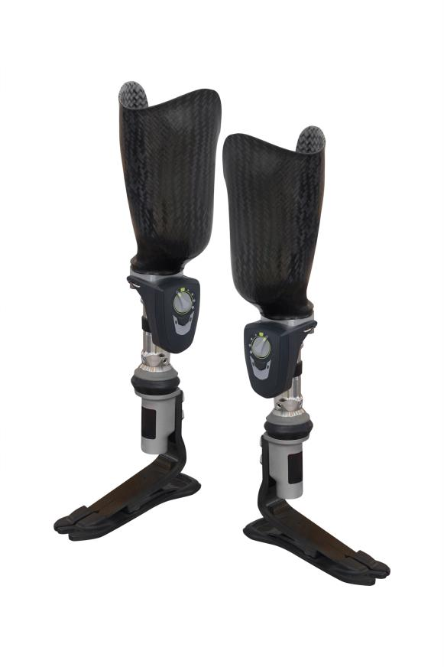
Introduction
A healthy ankle-foot system is necessary for efficient and symmetrical gait.
Persons with lower-limb amputation lose this system and rely on prostheses to walk.
Figure 1. Transtibial prostheses with ESR feet; Image licensed from https://stock.adobe.com/.

Slide 3
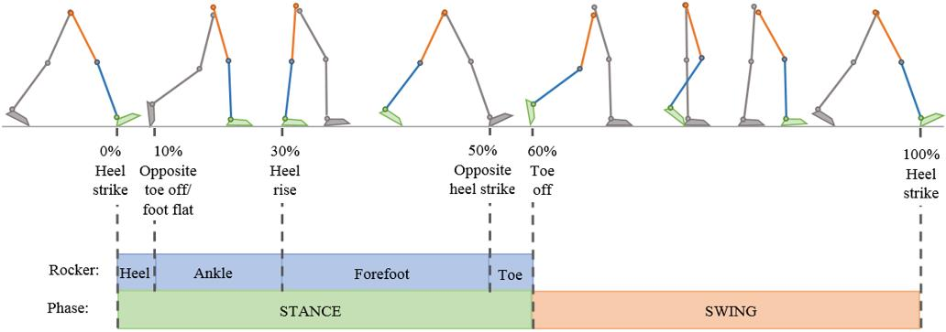
Typical Gait
Stance phase divided into four rockers: the heel, ankle, forefoot and toe rockers
Figure 2. Gait cycle, the figure shows stance and swing phase, the main events that take place during stance and the rockers of the stance phase. (Kolbeinsdóttir, 2018).

Slide 4
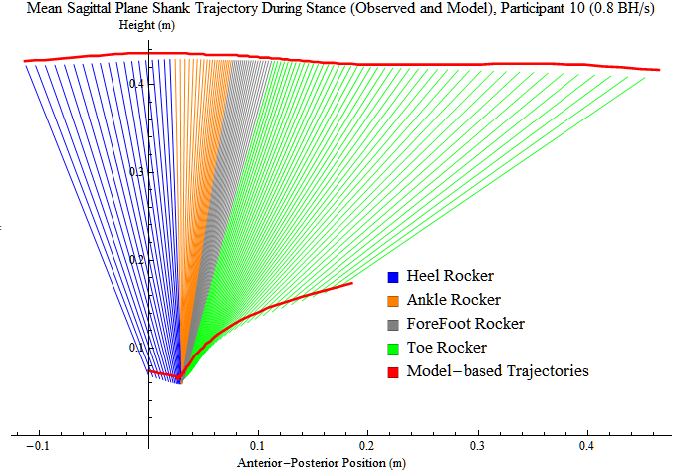
Typical Gait
Typical shank trajectory in sagittal plane along stance phase.
Knee joint center found to maintain horizontal trajectory.
Figure 3. Observed and model-based sagittal plane shank trajectory, colored by rocker, during stance for one representative participant walking at 0.8 BH/s. Upper trajectory corresponds to knee joint center, and lower trajectory corresponds to ankle joint center. (Pollen, 2015).

Slide 5
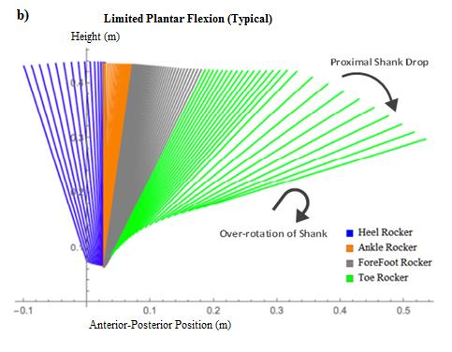
Prosthetic Gait
Prosthetic gait doesn’t allow for plantarflexion past neutral
Knee joint center originally hypothesized to drop along with shank over-rotation
Figure 4. Predicted sagittal plane shank trajectory during stance with ankle plantar flexion restricted past neutral in typical gait (Pollen, 2015).

Slide 6
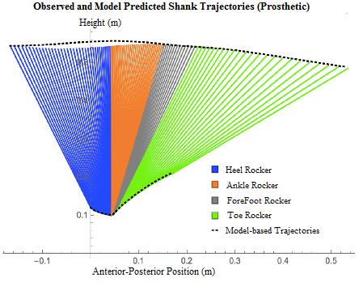
Initial Findings
Initial findings showed little drop in knee joint center
Hypothesized that stance phase terminated early by user
Small sample size limits power of study
Figure 5. Predicted sagittal plane shank trajectory during stance with ankle plantar flexion restricted past neutral in typical gait (Kolbeinsdóttir, 2018).

Slide 7
Hypothesis
Prosthetic users terminate stance phase early to prevent excessive shank rotation and the lowering of the shank’s proximal end; showing similar results to the initial findings.
Goal: Understand prosthetic gait in order to enable prosthetic users to maintain the shank’s horizontal trajectory and lead to a more symmetric gait.

Slide 8
Visual 3D
Motion capture files analyzed in Visual 3D
Gait events mark beginning and end of each rocker
Figure 6. Dynamic model in Visual 3D, marking gait events for each of the four rockers.

Slide 9
Results
Proximal end position of the shank in the z-axis shown to be horizontal in most cases
Cases showing drop in proximal end position possibly due to differences in prosthetic device
Figure 7. Proximal end position of the shank in the z-axis over a full gait cycle

Slide 10
Results
Table 1 shows mean excursion angles during each rocker and percent contributions of both ankle and foot-to floor excursions to shank excursion
Table 1. Angular excursions for ankle, foot and shank at each rocker and total during stance (mean ± standard deviation) as well as percent contributions of the ankle and foot-to-floor excursions to shank excursion for prosthetic gait. Negative excursions signify ankle plantar flexion and rotations of the foot and shank in the direction of forward progression. A negative percentage indicates the contribution opposed the resultant angle of the shank.

Slide 11
Results
Table 2 shows horizontal and vertical translational displacements at each rocker as well as percent contributions of the proximal end of the foot’s displacements to the proximal end of the shank’s displacements
Table 2. Horizontal and vertical translational displacements of the proximal end of the foot and proximal end of the shank at each rocker and total during stance (mean ± standard deviation) as well as relative contributions of the proximal end of the foot’s displacements (horizontal, vertical) to the proximal end of the shank’s displacements for prosthetic and typical gait. Positive horizontal displacements signify anterior translation, positive vertical displacements signify a rise in the foot/shank’s position. A negative percentage indicates the foot’s displacement was in the opposite direction.

Slide 12
Conclusions
Seven of the nine additional subjects showed a horizontal trajectory of the proximal end position of the shank
Future directions include :
calculating step length to determine whether subjects terminate stance phase early on their prosthetic leg
determining if a difference exists in proximal end position of the shank with different prostheses

Slide 13
Acknowledgements
I would like to thank the University of Delaware Summer Fellows Program and the members of the Arch lab
for their support this summer

