Slide 1
Research Poster Design

Slide 2
Learning Objectives
Apply basic design principles to enhance your research poster
Evaluate examples of research poster designs for effectiveness
Explore resources for choosing color, finding images, templates, and using PowerPoint.

Slide 3
Nei Valente - brazilian graphic designer and street photographer 288 responses. (159-female, 113-male, 16-no answer

Slide 4
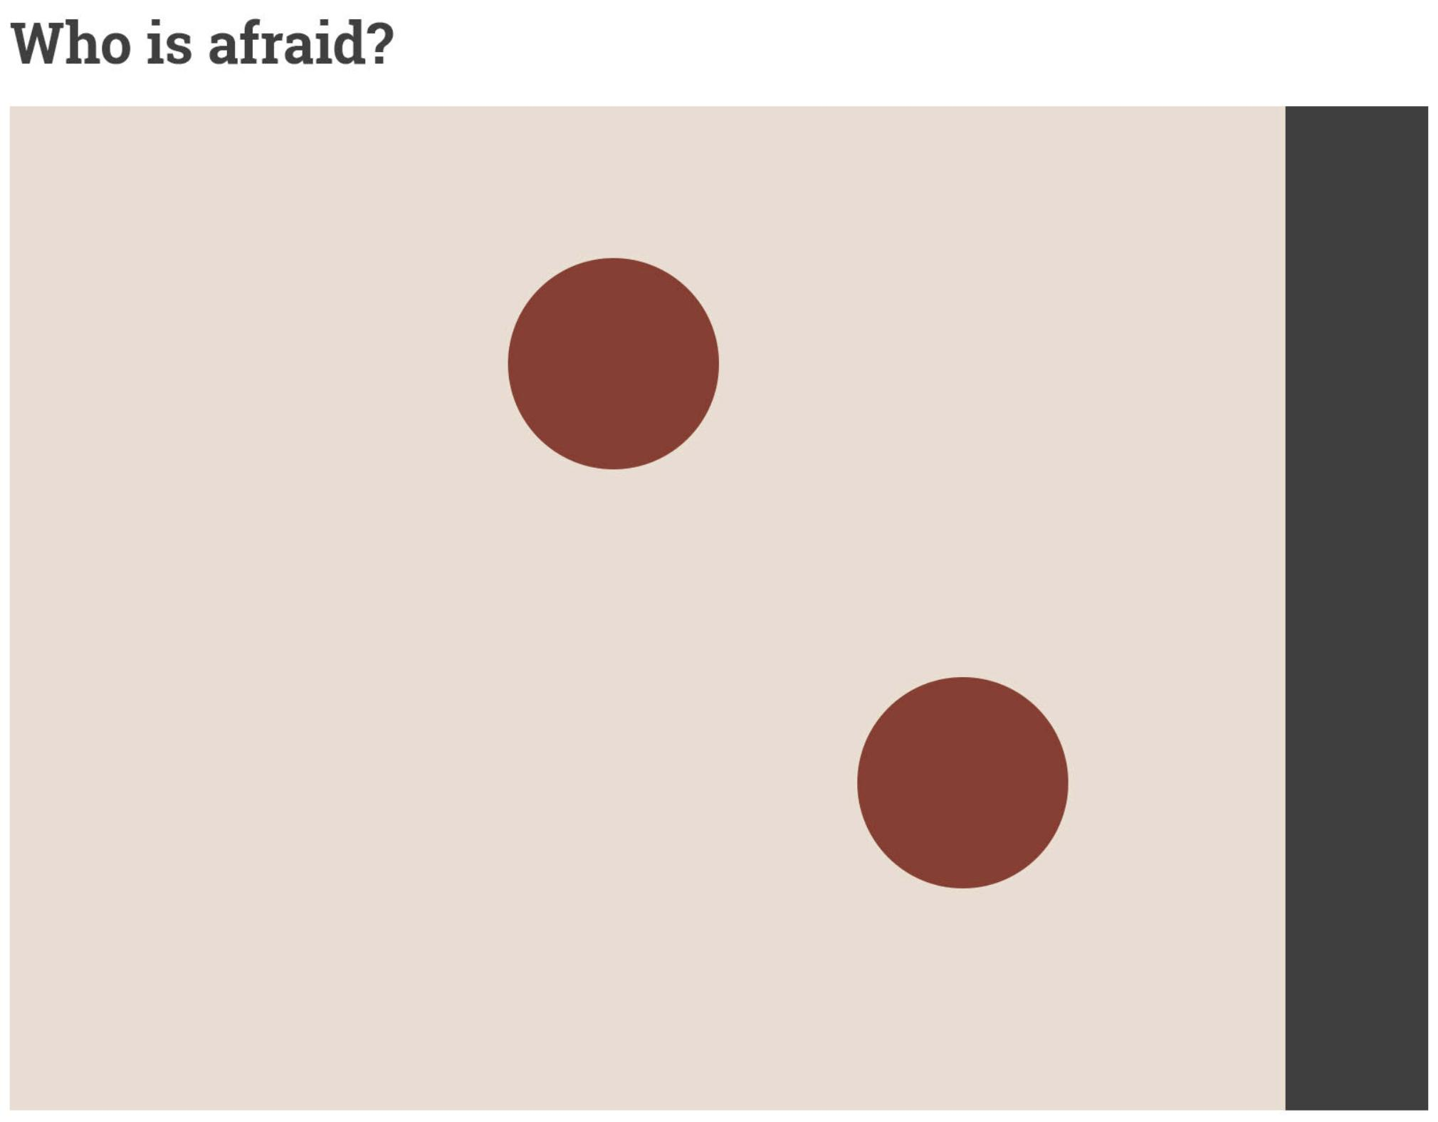
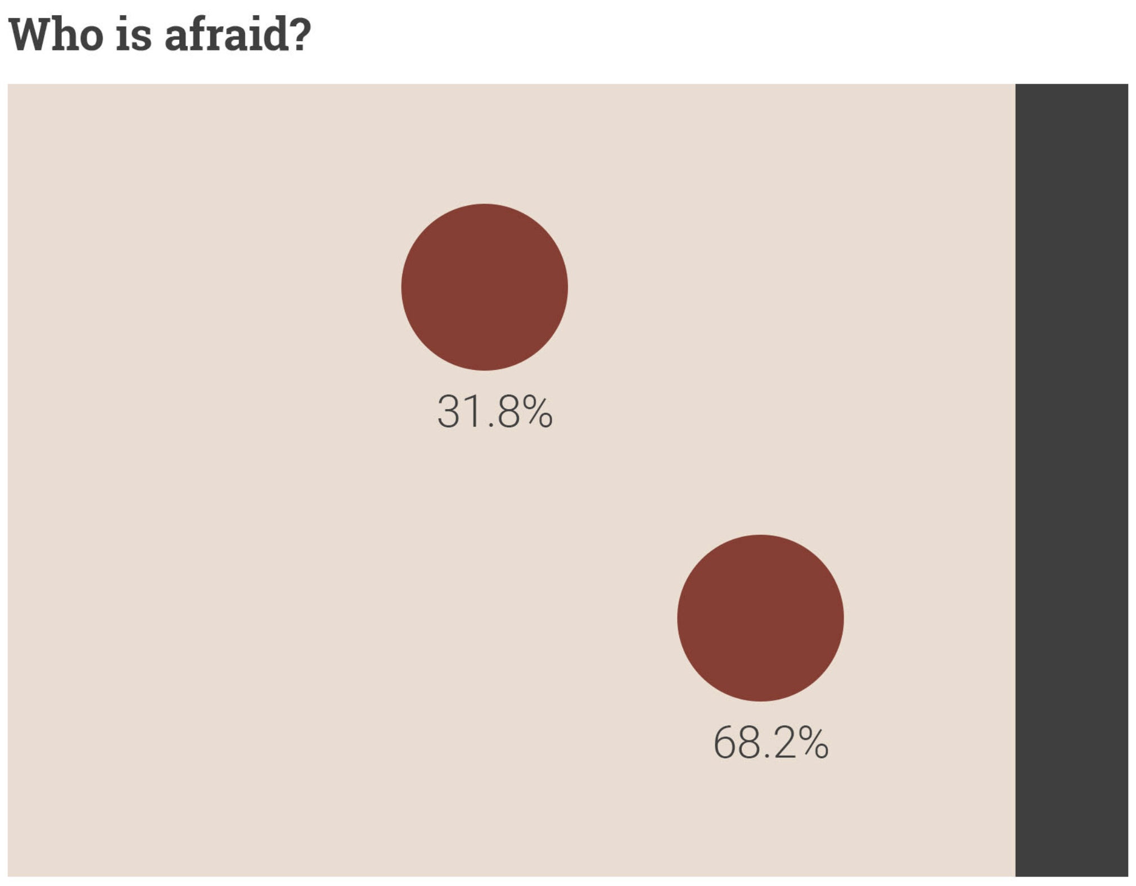

Slide 5
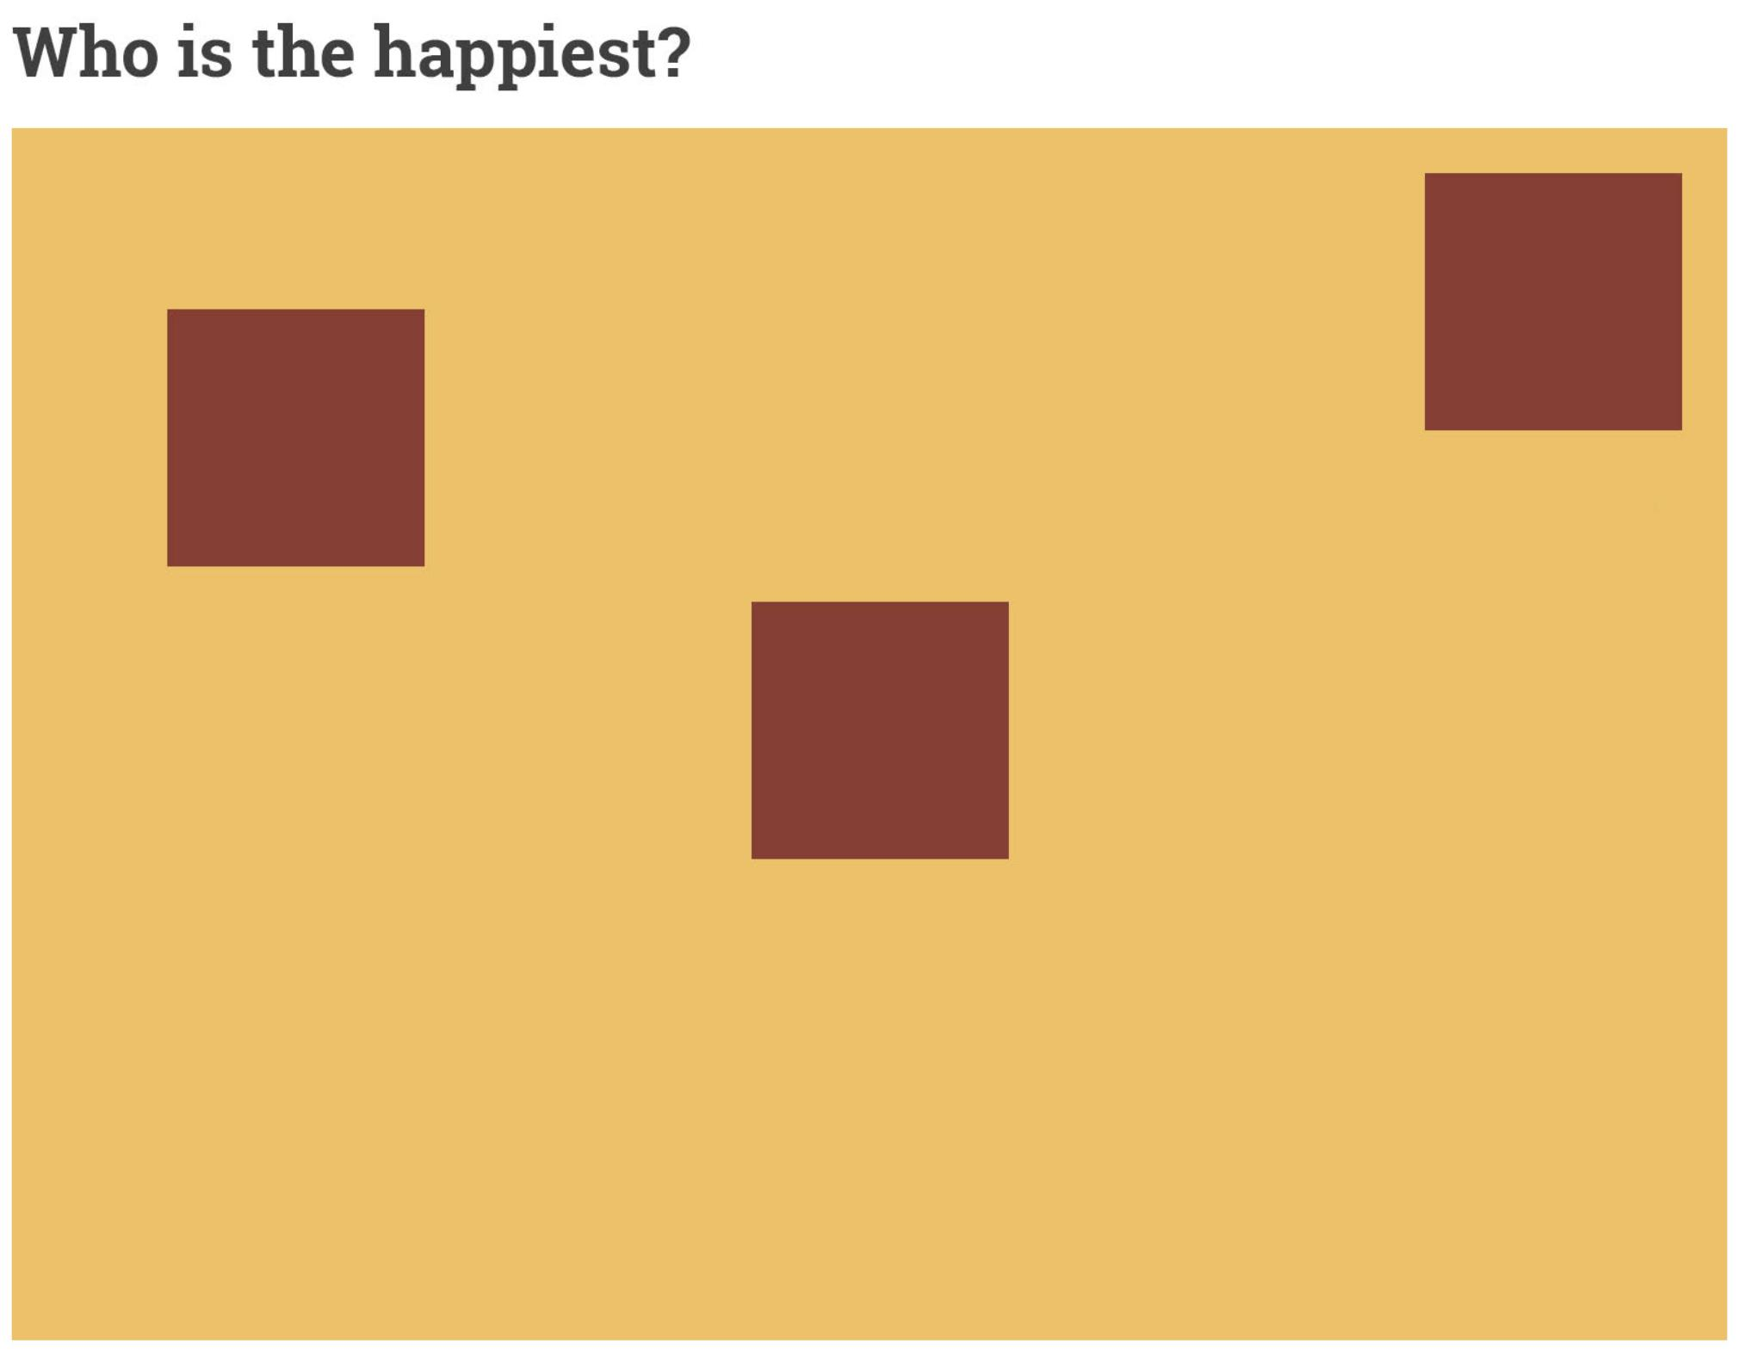

Slide 6
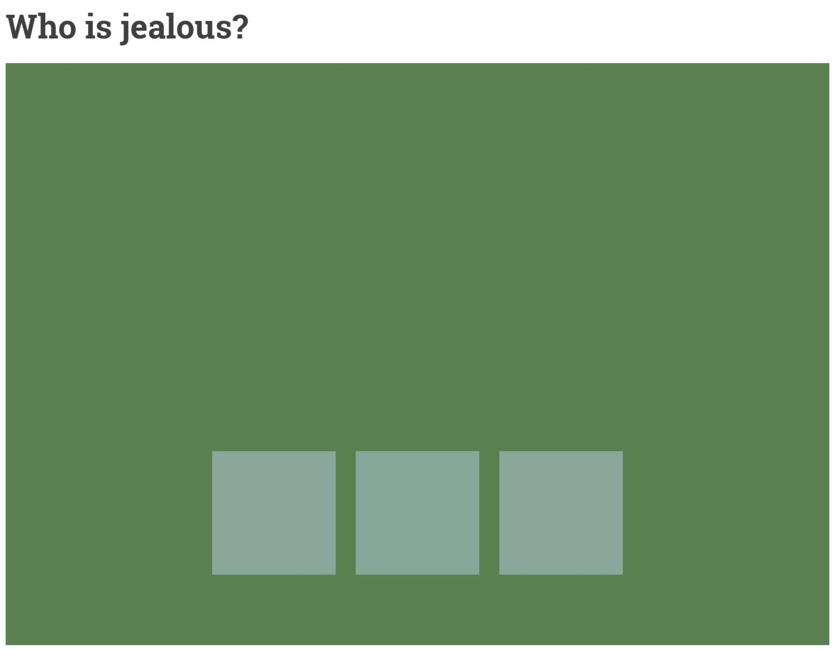
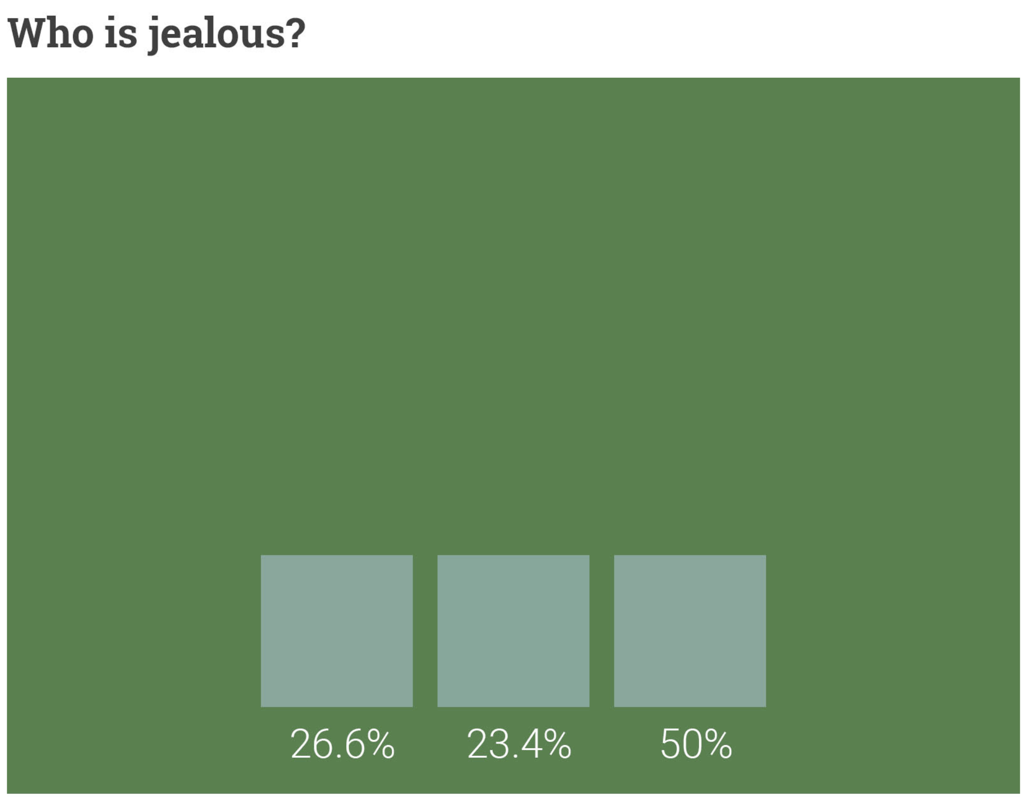

Slide 7
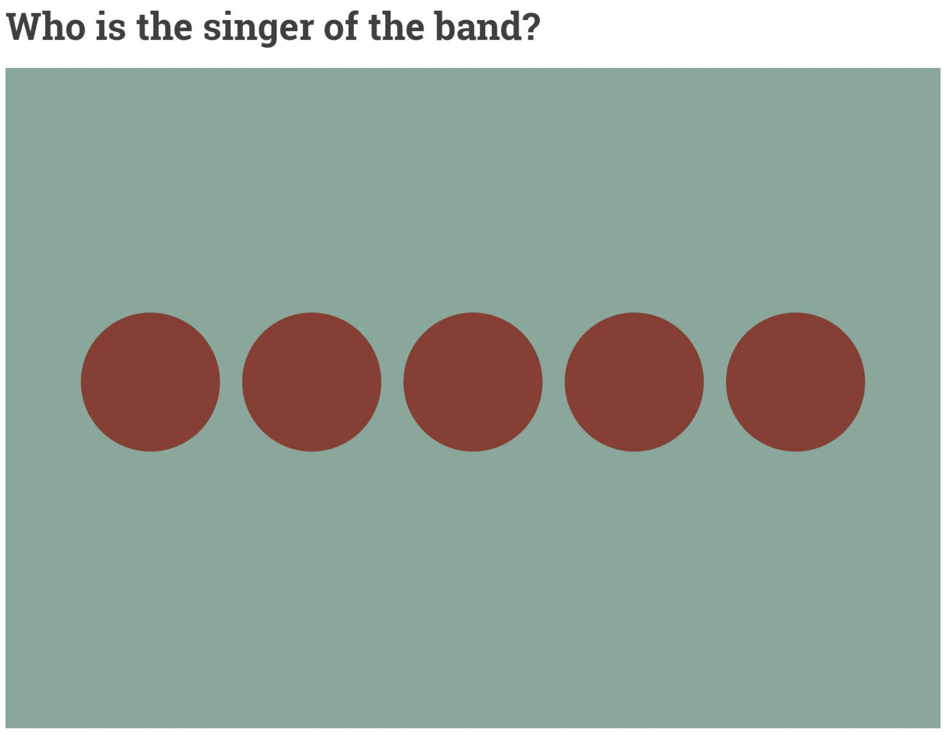
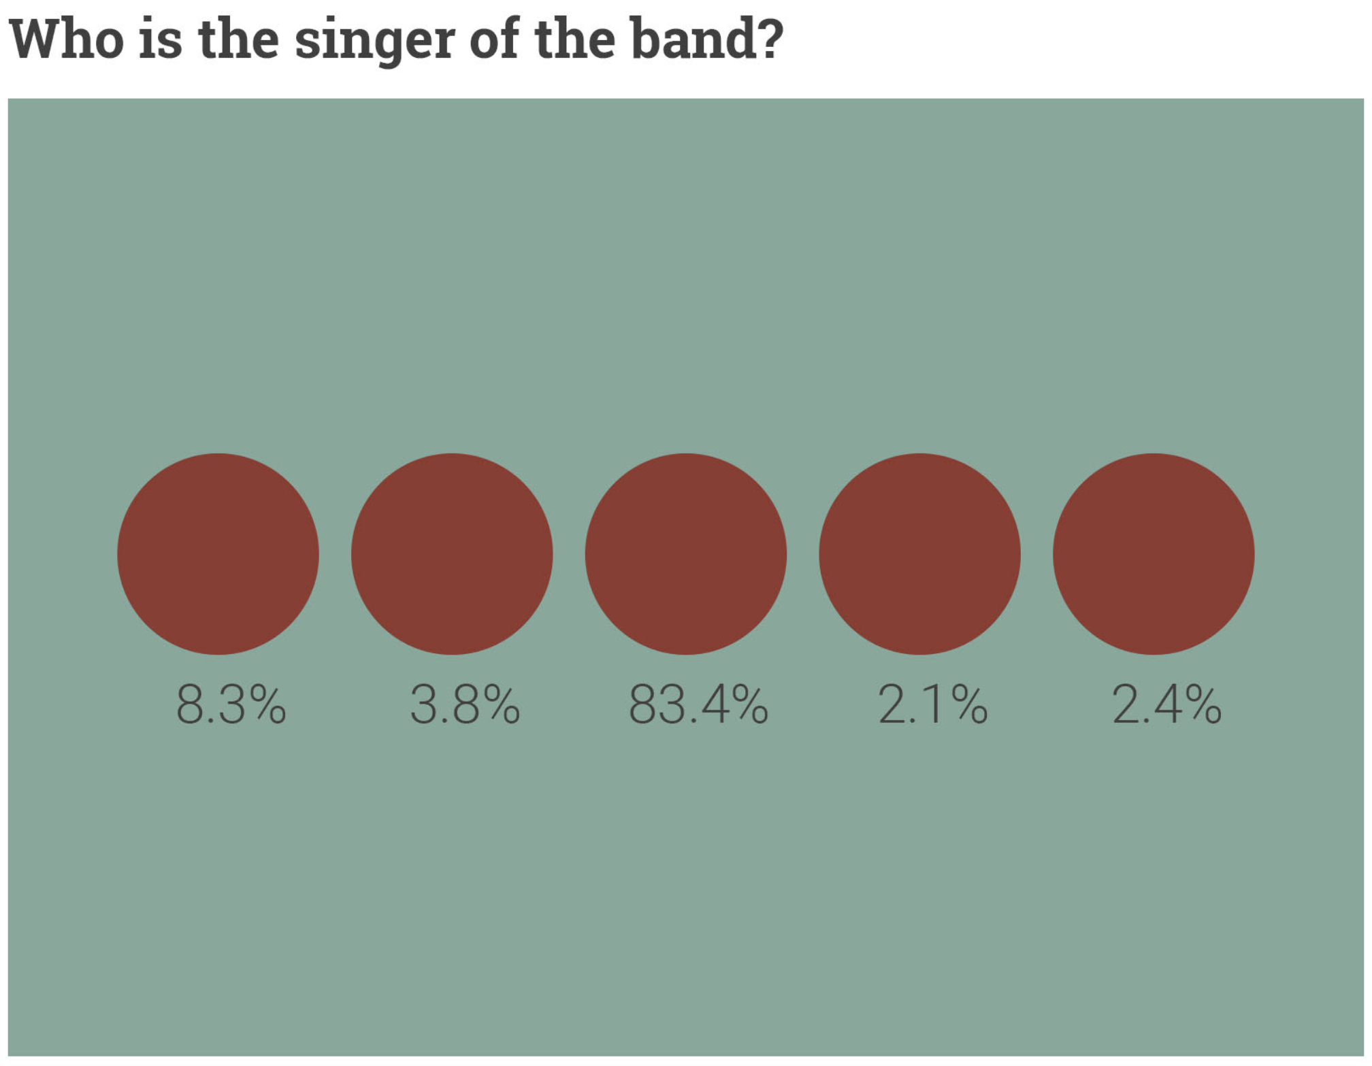

Slide 8
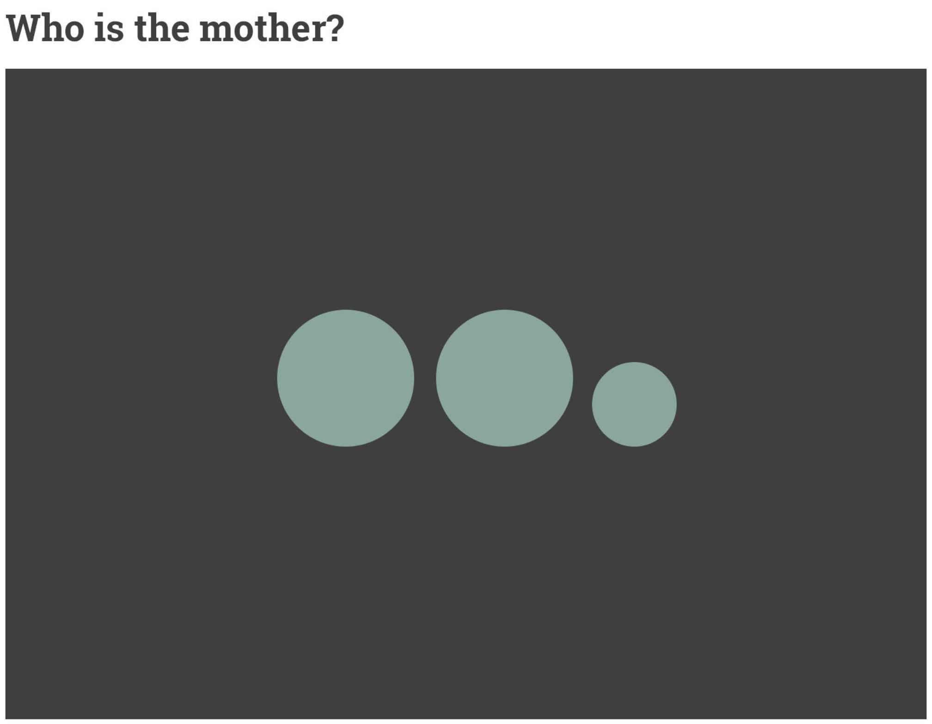
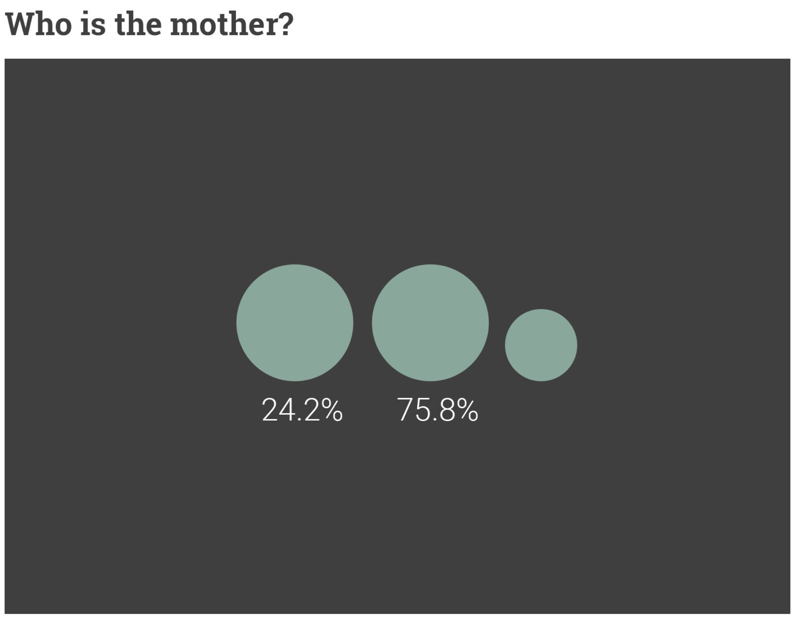

Slide 9
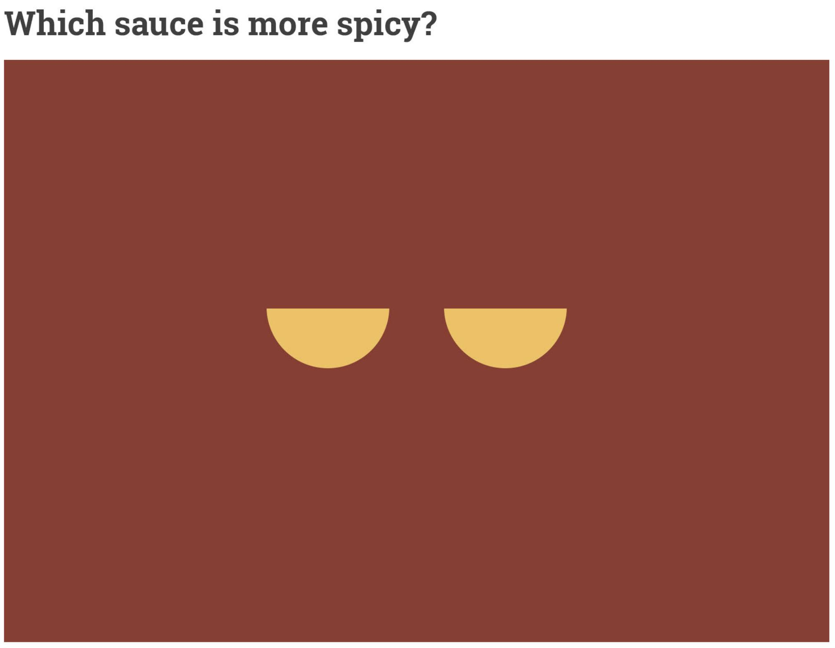
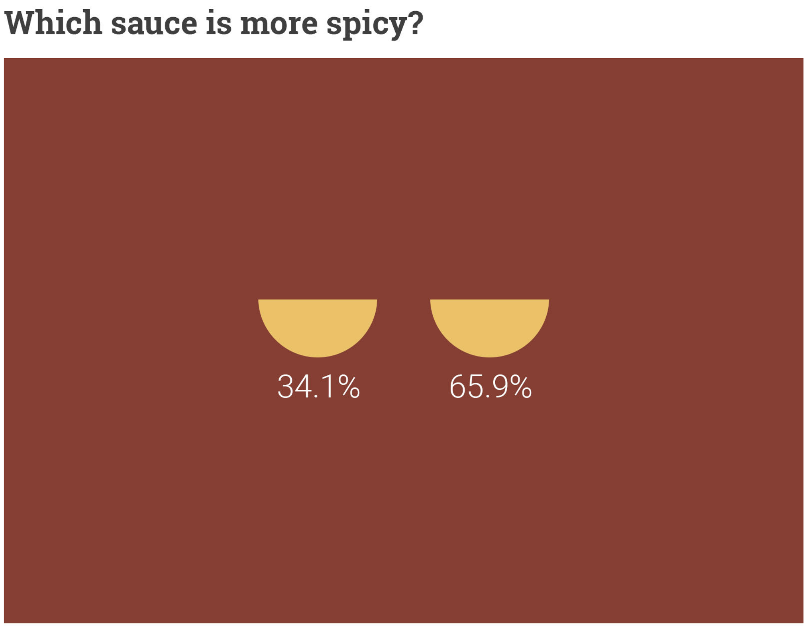

Slide 10
Design Matters
Everything about your design should be intentional
Anything that is not essential to getting your point across doesn't need to be there.
Be aware of visual hierarchy
Design around the predictability of the human eye
Design your poster to be read from top left to bottom right
Use size to bypass traditional conventions
Notes:
Visual hierarchy: The arrangement or presentation of elements in a way that implies importance

Slide 11
Many ineffective posters suffer from easy-to-fix problems, including ...
objective(s) and main point(s) hard to find
text too small
poor graphics
poor organization

Slide 12
Design your poster around your research.
Don’t just make your research fit into a template.

Slide 13
Design Principles
Proximity
Alignment
Repetition
Contrast

Slide 14
Proximity
Group related items together.
Physical closeness implies a relationship.
If information is organized, it is more likely to be read and remembered.

Slide 15
No Proximity
My Shopping List
Fruits:
Oranges
Pineapples
Vegetables:
Peas
Carrots
Meats:
Bacon
Pork
Notes:
Here we have no proximity, because everything is equal distance apart in this list, even though it looks like there could be natural groupings.

Slide 16
Better Proximity
My Shopping List
Fruits:
Oranges
Pineapples
Vegetables:
Peas
Carrots
Meats:
Bacon
Pork
Notes:
If we just group like items with the heading, and provide more space between the different categories, this list suddenly is more organized and easier to read. With your research poster, you will probably have different elements like background on your project, the question your research asks, your methods and results, and a conclusion. You want to make sure the heading for each of these units of information have a nice proximity to your text, and you want to make sure there is enough space between these units to distinguish them as different.

Slide 17
Proximity tips for research posters
Make sure headings are close enough to body text
Make sure caption text is close enough to graphics
Make sure there is enough space between different sections to distinguish them as different

Slide 18
Repetition
Repeat some aspect of the design throughout the piece.
Repetition is about consistency. It is a conscious effort to unify all parts of a design.
Notes:
Repetition is the third principle of design. You want to repeat some aspects of your design throughout- this could be through color, shapes, spatial relationships, line thickness, font, size, etc.

Slide 19
Bad Repetition
My Shopping List
Fruits:
Oranges
Pineapples
Vegetables:
Peas
Carrots
Meats:
Bacon
Pork
Notes:
Here we have our previous example of no proximity- there is also bad repetition going on. We have a title, category headings, and items, but they all look the same and it’s not immediately clear that they should be distinguished.

Slide 20
Better Repetition
My Shopping List
Fruits:
Oranges
Pineapples
Vegetables:
Peas
Carrots
Meats:
Bacon
Pork
Notes:
With repetition, you can distinguish the title, headings, and items and then repeat that design for similar items. So the title is the largest, but the category heading is distinct from the item. By making the headings the same, we can quickly understand what they are and what function they serve.
******With your poster, you can pay attention to repetition through your color scheme, which will will talk about soon, and by creating the same visual look for your different boxes.

Slide 21
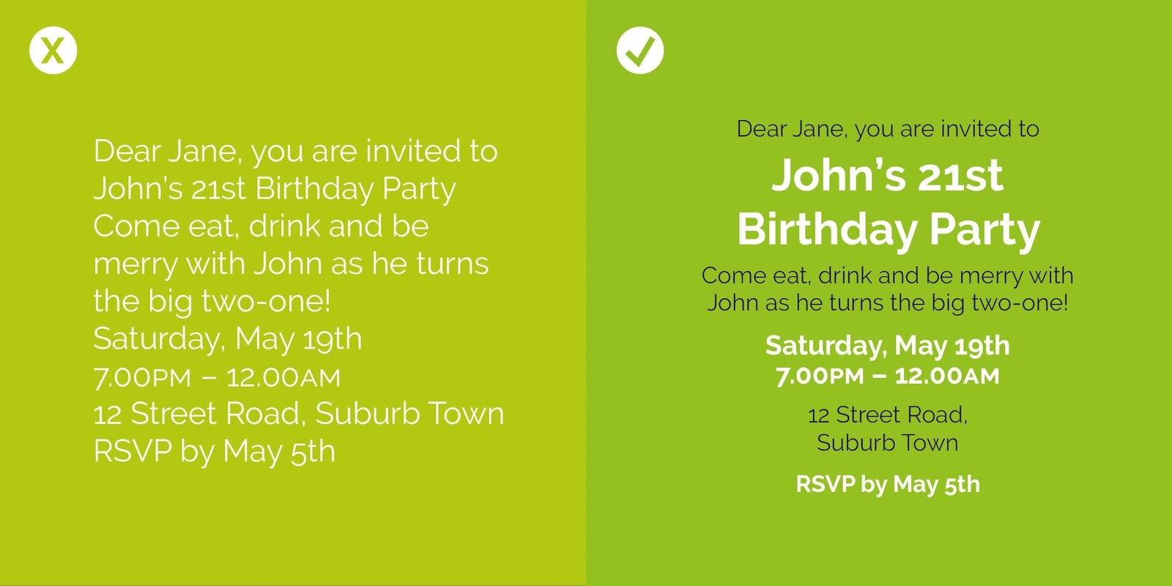

Slide 22
Repetition tips for research posters
Repeat design elements such as:
color
shapes
spatial relationships
line thickness
font
font size

Slide 23
Alignment
Nothing should be placed on the page arbitrarily.
Every item should have a visual connection with something else on the page.
Unity is an important concept in design.
Notes:
Next, we have alignment. Everything about your research poster design should be intention. Nothing should be placed on the page arbitrarily. You want to make sure with every item that you’re establishing a visual connection with something else on the page. This will make your poster have a more united and cohesive feel; it will create a clean and polished look to your poster.

Slide 24
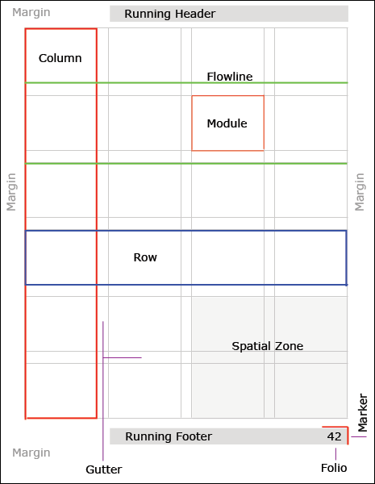
Using a grid is a common graphic design technique and can be very helpful in laying out your design.
Notes:
One way to think about alignment is through a grid. This is a common technique that can help you layout your design so that you have a plan and know how much space you’ll have for different elements.
Grids make information easier to communicate and deisgn more compelling
Grids can enable you to be more creative- don’t need to always worry about layout concerns- allows you to focus energy on developing strong copy, typography, graphics for project
Grids give structure that makes laying out elements like text and images easier because you don't have to agonize about where to place eache elemtn
Use the grid to define your alignment and then dont have to worry about it
Margins- resting palce for readers eyes, seperate columns of text, define different sections
Too narrow- visual tension, hard to tell where one thing begins, another ends
Too wide- elements without clear connections, harder to determine hierarchy of info

Slide 25
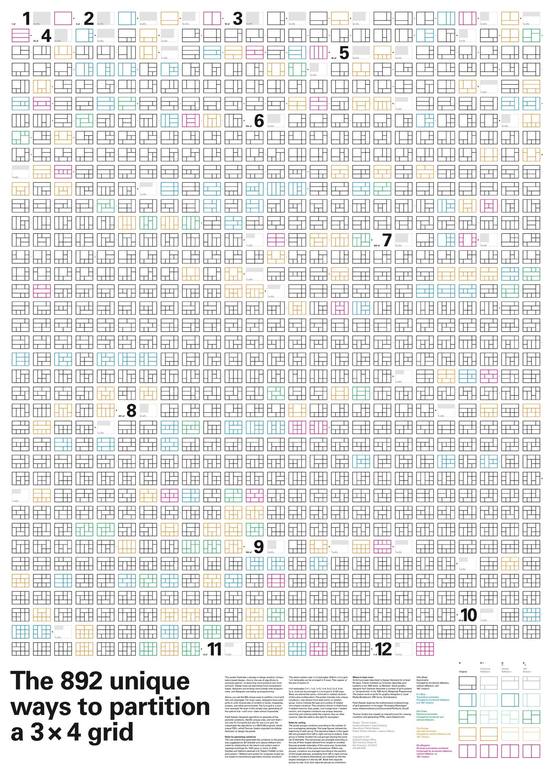
Image courtesy of Dubberly Design Office

Slide 26
Alignment for research posters
Use left align for body text
Use a grid to help with your layout, BUT also…
Modify templates if needed
Make sure sections on your poster are consistently aligned
Be consistent with margins and spaces between sections
Notes:
Text alignment creates a distinct feel depending on what you choose. Each basic mode of alignment (left, centered, right, justified) has distinct characteristics and typical uses. Centered alignment is more common for poetry; there is a visual flow that goes along with the flow of the poem. On the opposite end of the spectrum, justified connotes more of a business setting, with its sharp and clean edges.
****So you have two ways to think about alignment with your research poster. For text alignment, I would recommend using left alignment for your text on your poster. It will allow for the text to be evenly spaced. You might be tempted to use justified to fill the space with your text, but this can actually be harder for viewers to read, due to the variety in spacing. The other way to think about alignment is with your different elements (background, results, etc.) This is often what stands out to me in less effective poster designs. Having these boxes aligned on your poster goes a long way to making your poster look polished and clean.

Slide 27
Contrast
Contrast is one of the most effective ways of adding visual interest.
Useful for creating an organizational hierarchy among different elements.
If two elements are sort of different, but not really, then you don’t have contrast– you have conflict.
Notes:
Finally, our fourth principle is contrast, which is a great way to add visual interest. You can use contrast to create an organizational hierarchy among different elements. You want to make your contrast distinct. If you’re elements are not the same, then make them very different. Contrast plays a big role in grabbing your reader’s attention and drawing them into your poster.

Slide 28
These are different | But not different enough.
Contrast things by making them different.
Very different.
Notes:
Any questions about the four basic principles?

Slide 29
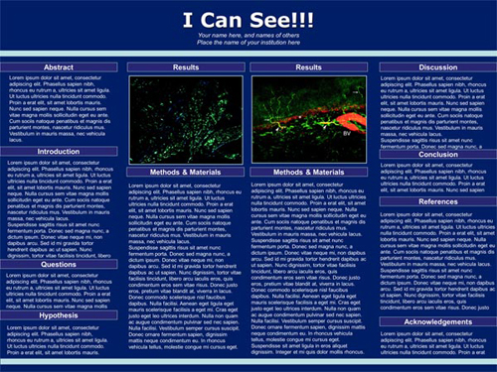

Slide 30
Contrast tips for research poster
Make sure there is enough contrast between your text and background
Black and white have the highest contrast- easiest to read
Use contrast to catch your reader’s attention

Slide 31
Type Classification
Serif
Serif fonts have small strokes or tails at the end of the letters
Creates a more traditional and formal look
Good for print; body text
Sans Serif
Sans serif don’t have tails
Creates a more clean, modern look
Good for print headlines, digital body text

Slide 32
Typography tips for research posters
Don’t go smaller than 24pt font
Sans serif reads better on posters (especially in digital format)
Limit the number of fonts- one for heading/title and one for body text

Slide 33
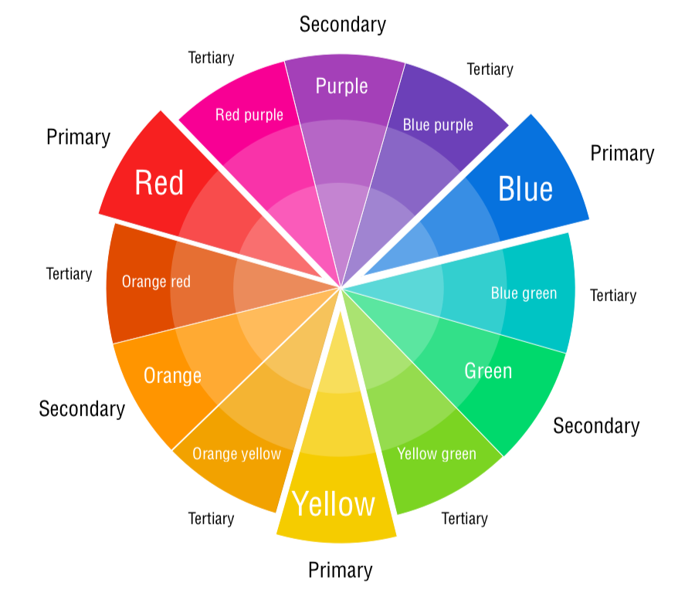
Color can:
Evoke emotion
Create emphasis
Group related elements
But it can also:
Overwhelm your audience
Cause distraction
Notes:
Next, we’re going to talk about color theory. You might remember this best from elementary school art classes, but thinking intentionally about your color scheme can go a long way towards making your poster stand out.

Slide 34
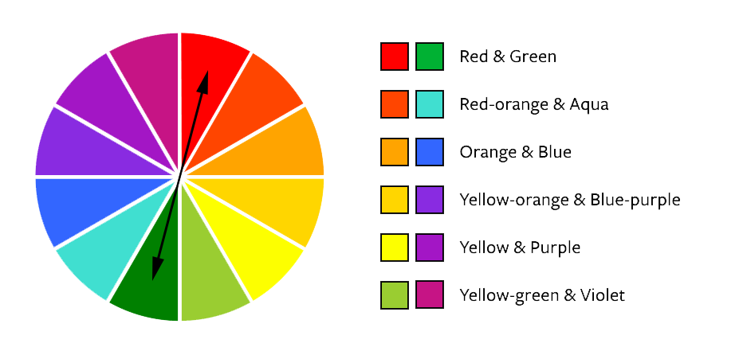
Complementary Colors
Notes:
One way to create a color palette is through complementary colors, which are combinations of colors across from each other on the color wheel. These combinations have high contrast but you want to be careful to not overuse these colors, which could make your poster jarring. These are great to make something stand out.

Slide 35
Split-complementary Colors
Notes:
Split complementary is similar, but instead of the opposite color, you use the two colors next to it.

Slide 36
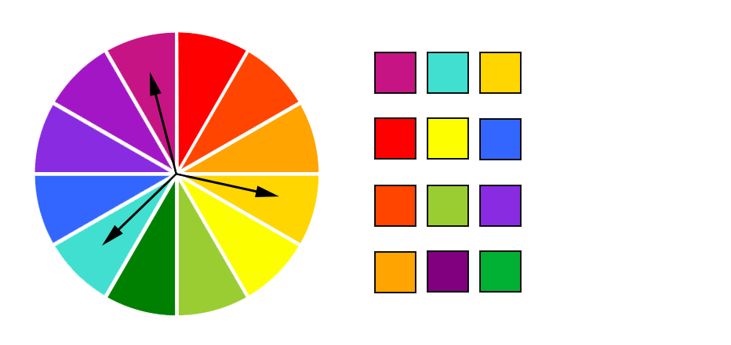
Triad
Notes:
Triad pulls three colors, evenly spaced from the color wheel. The square color scheme is similar, but uses four colors. The key to all of these colors schemes is to not use all the colors equally. You want to pick a dominant color and use the other colors to draw attention to elements you want your reader to take notice of. An easy way to create a balanced presentation is to stick by the 60-30-10 rule. This means that if you’ve chosen three colors, as recommended above, then you should devote 60 percent of the space on your slides to the primary color, 30 percent to the secondary and 10 percent to the accent color.

Slide 37
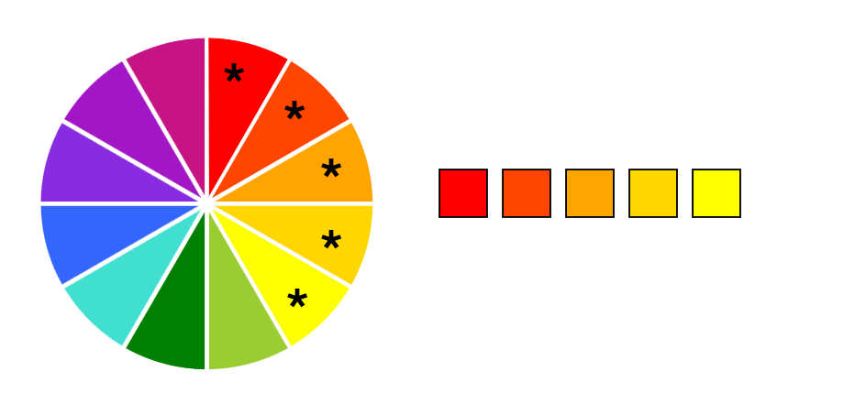
Analogous
Notes:
Analogous uses colors that are next to each other on the color wheel. This is useful if you want to use all warm or all cool colors for your poster. Split analogous is similar, but uses every other color.

Slide 38
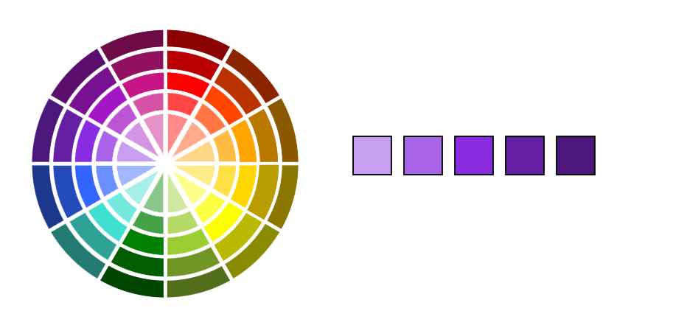
Monochrome
Notes:
Monochromatic uses one color and different shades, tints and tones of the color.

Slide 39
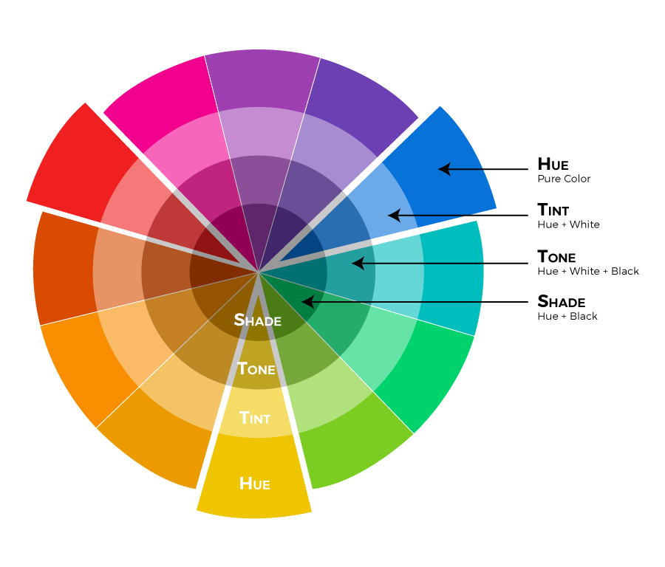
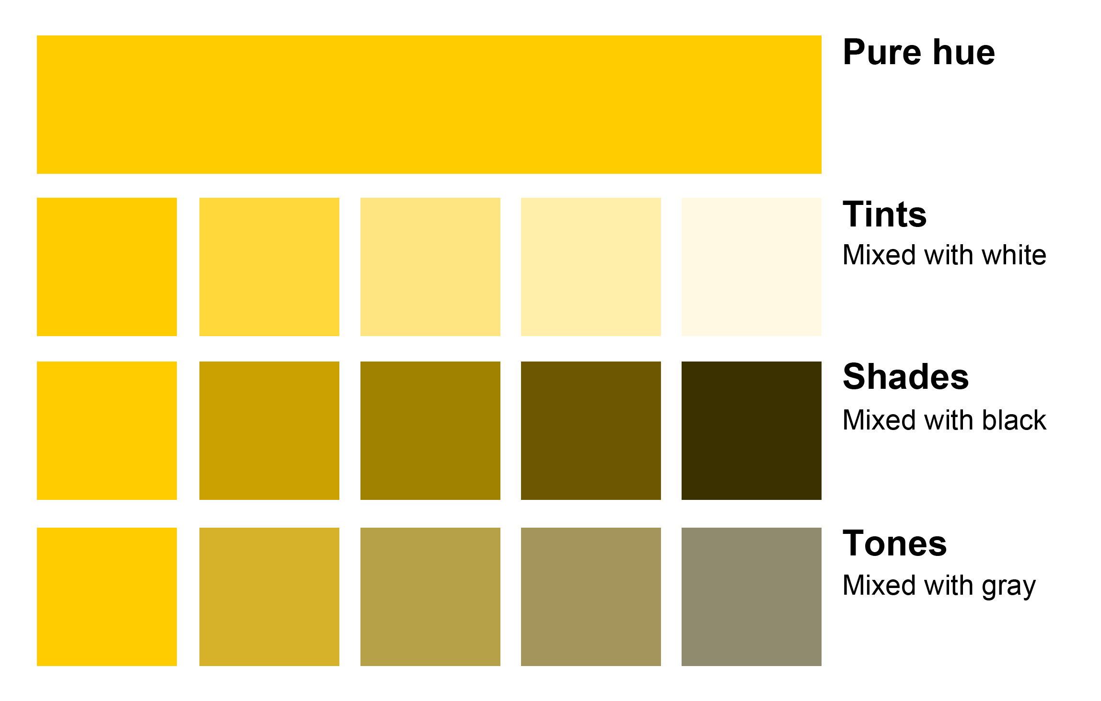
Shades & Tints
Notes:
The hue is the pure color, at its more saturated point. We are looking at hues with the color wheel. When you add white, you create a tint. When you add black, you create a shade. When you add grey, you create a tone. Using tints, shades, and tones can create a more sophisticed look for your poster, whether you create a monochromatic color scheme, or just use tints/shades/tones in any scheme. It can also be really eye-catching to use a monochromatic scheme with one complementar color used sparingly to make things stand out.
On the google doc there are a few tools for creating your own color palette. Adobe color and Coolors.

Slide 40
Color tips for research posters
Choose a color palette of up to 3 colors
Complementary and monochrome palettes work well
Play with different hues of the same color
60/30/10 rule
60% dominant color
30% secondary color
10% accent color- great for drawing viewer’s attention

Slide 41
Images
Use high resolution images
Download the highest quality available
For digital posters, the typical resolution is 72 ppi (300 for printing)
Make sure you have permission to use the image OR
Find Creative Commons or other openly-licensed images to use
Make sure to provide proper attributions for everything you use

Slide 42
Perception of Color

Slide 45
Poster Evaluation Activity
10 minutes for breakout rooms.
Come up with 3 observations about the effectiveness of the design. Consider these questions:
What elements of the poster design are effective or ineffective?
Does the design draw you in? Do you want to learn more?
How does the poster employ proximity, alignment, repetition, and contrast?
What would you change?
Go to: https://bit.ly/posteractivity

Slide 46
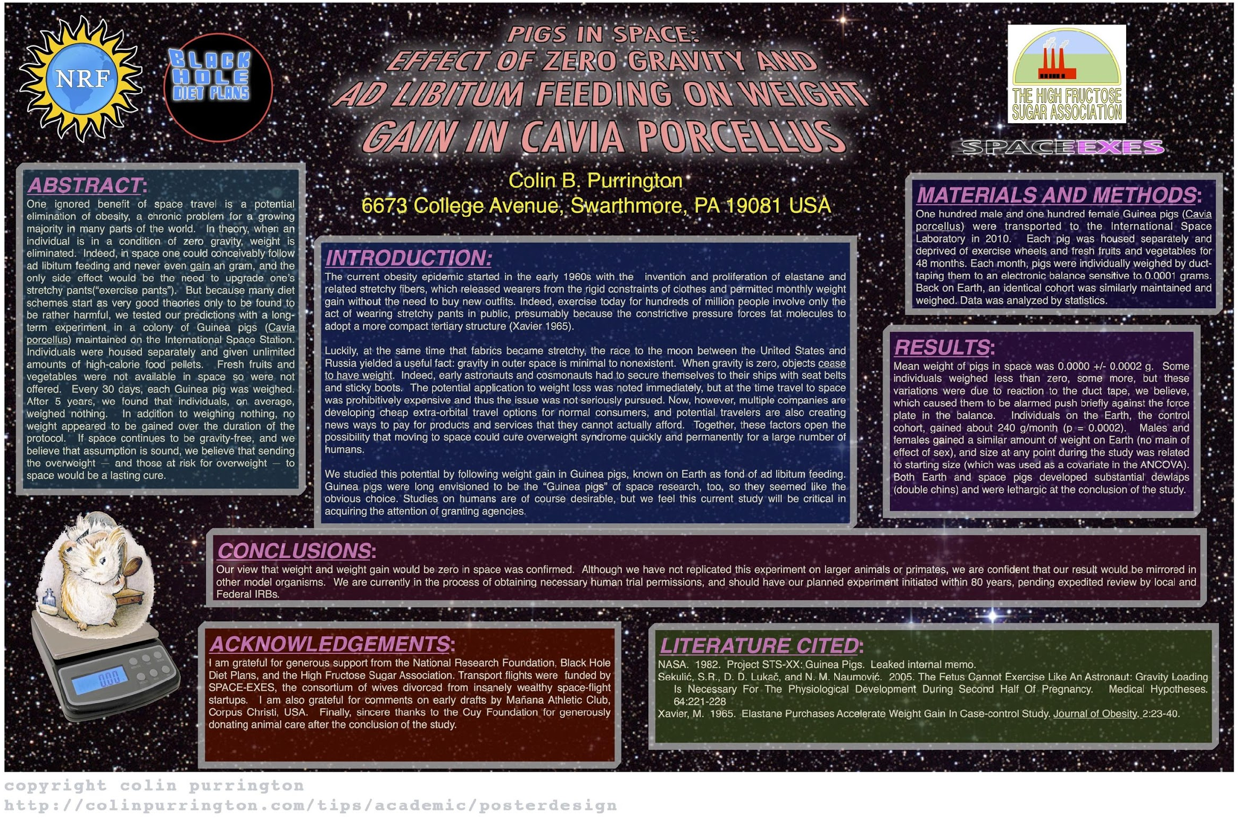

Slide 47
phdposters.com

Slide 49
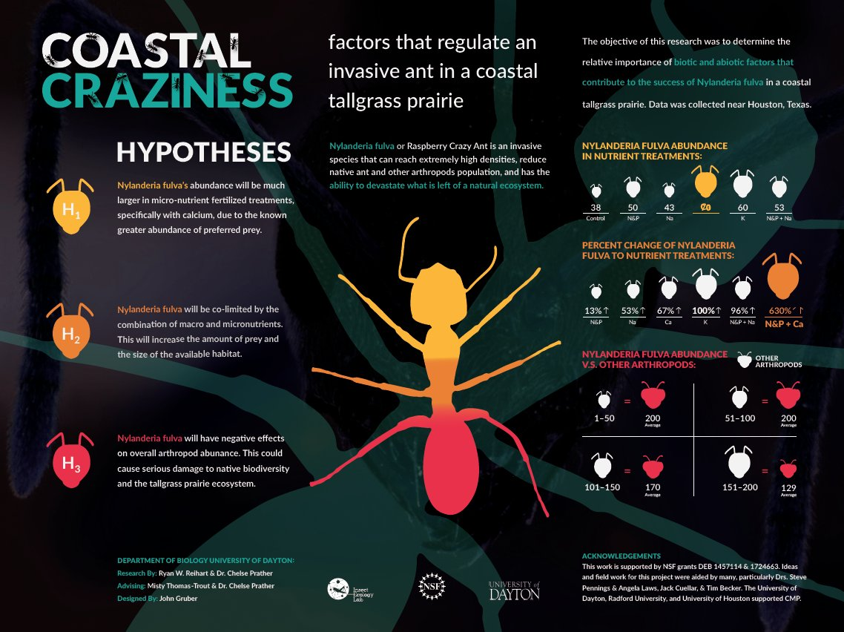

Slide 51
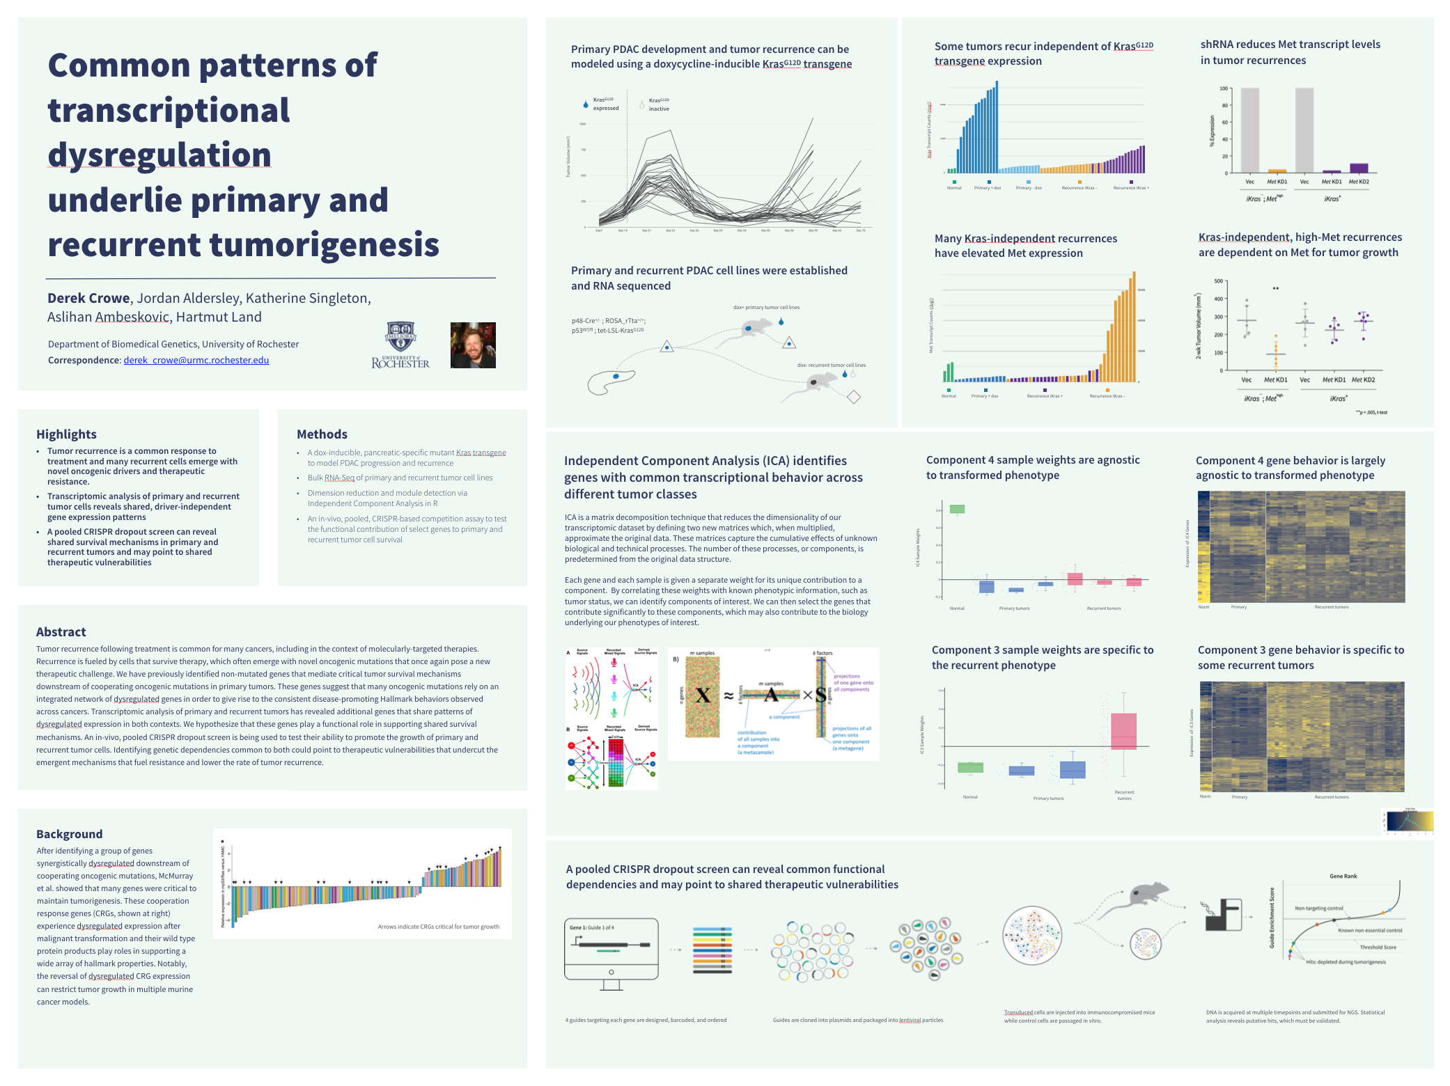

Slide 52
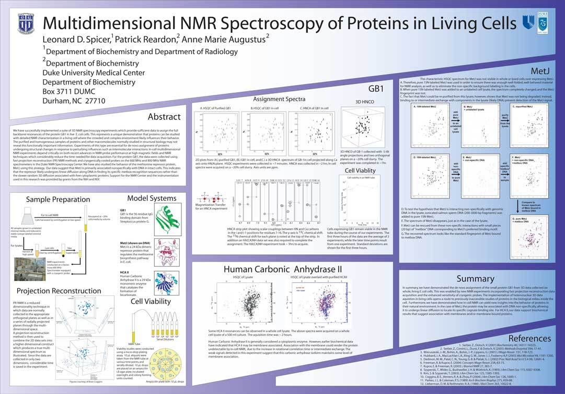
phdposters.com

Slide 53
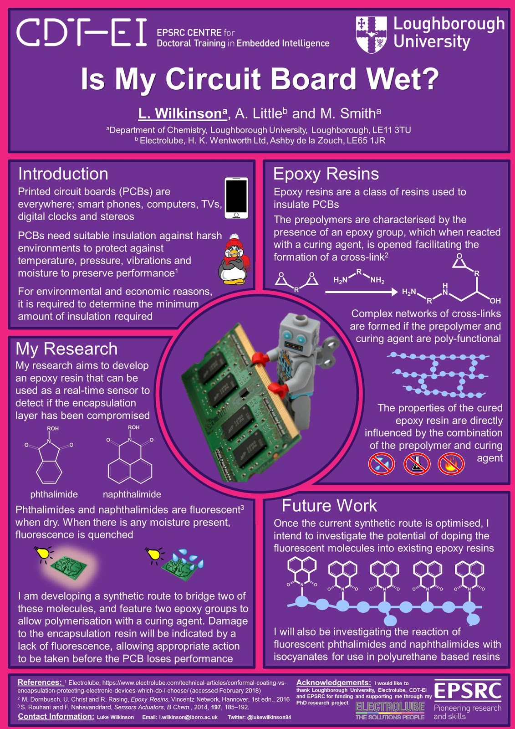
http://betterposters.
blogspot.com/
http://betterposters.
blogspot.com/

Slide 54
Recording your video
Use Zoom to record yourself or another tool you are already familiar with
Check your lighting
Use headphones with a mic to record if you have them
2 minutes = 1 page 12pt font (~500 words)
Make sure its the correct format- MP4 file
If you have any questions about recording your video, email AskSMDC@udel.edu
We can answer questions by email or you can schedule a Zoom consultation.

Slide 55
Helpful Links
Graphic Design guide
Free Design Tools
Research posters (includes templates)
Video guide
AskSMDC email
Presentation slides

