Slide 1
Presenting your Research Presentation Poster
Christopher Volker, Associate Director of Oral Communication
University Writing Center
chvolker@udel.edu

Slide 2

Who am I?
Oversee the Oral Communication Consultants
Teach Public Speaking Courses here at UD
Dog Dad to Penny

Slide 3

Who are you?
Name
Major
(1) sentence summary of your project
**Use Raise Hand function to indicate willingness to participate

Slide 4
Overview
Goals of the Poster Presentation
Presentation Essentials (Face-to-Face)
Digital Web Presence (via Zoom, Skype, etc…)

Slide 5

Poster Presentation Delivery Considerations
Goal: To spark a scholarly conversation regarding your recent research
Who: Consider your audience
  What are their motivations? What do they know? How familiar are they with similar work?
Think: Elevated Conversation
  Formal and poised; natural and personable

Slide 6

Presenting your Poster
Create a succinct overview of your poster
  Introduce yourself
  Develop a “standard” 2-3 minute pitch
Provide the foundation: What do they need to know?
Spark the Conversation: pitch encourages them to ask questions, discover more, and leave with key takeaways

Slide 7

“Standard” Research Presentation Pitch
What was the problem you investigated?
Overview of methods (Summary)
Most interesting findings
Implications/ Next steps
Why is this important? What did you learn?

Slide 8

Delivery Basics: Face to Face
Body Posture: Tall, firm base, positioned towards audience
Eye Contact: Engage with your audience not your poster
Physical Space: Space between speaker and the audience
Vocal Efficacy: Slower pace, varied tone, clear articulation
  Allow your audience time to process your poster AND the message

Slide 9

BET on your Web Presence
Behavior: Body Language and Eye Contact
  No swiveling, tapping or gestures that obstruct view/ cause distraction
  Look directly at camera, engage in positive non-verbals
Environment
  Lighting: avoid windows, conditions that cause harsh glare/ shadows; light from behind device
  What can the audience see? Clean, quiet, free from distractions
Technology
  Check your technology, sound, camera angles, etc…

Slide 10

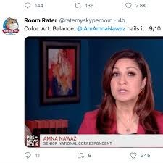
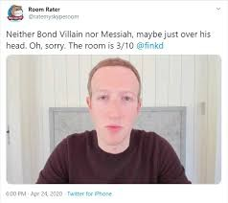
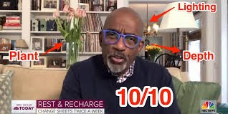

Slide 11
Questions?
Christopher Volker, Associate Director of Oral Communication
University Writing Center
chvolker@udel.edu

