Slide 1
Getting Started in Research: What it is, and why you might want to do it
Iain Crawford, Faculty Director, Undergraduate Research Program
Lauren Barsky, Associate Director

Slide 2
Research: What is It?
According to the Oxford English Dictionary:
“Systematic investigation or inquiry aimed at contributing to knowledge of a theory, topic, etc., by careful consideration, observation, or study of a subject. In later use also: original critical or scientific investigation carried out under the auspices of an academic or other institution.”

Slide 3
Research: What is It?
A more up-to-date and inclusive definition, though, would be something like this:
any process that leads to the creation of new knowledge, including through creative activity. The fundamental quality of all research is that it seeks to make an original contribution to the field, helping us understand life and the world around us in new ways
In other words, research and creative activity are part of every discipline of knowledge, and at UD it can be done in any major

Slide 4
Research: What is It?
According to the Carnegie system of classification, UD is “a Doctoral University with the Highest Research Activity”
(aka an R1)
This means it’s among the elite knowledge-making institutions in the country and the world
AND, it also has a long history of including students as integral members of the research that happens on and beyond campus

Slide 5
Why Would You Want to Be Involved?
It’s amazing: stimulating, challenging, eye-opening, rewarding
You get to work with other researchers, grad students, faculty, making knowledge together
Studies show multiple benefits from participation:

Slide 6
Student researchers have deeper and richer experiences in their academic work
Participation increases self confidence as well as leadership and communication skills
Student researchers see gains in GPAs and higher persistence and graduation rates
And that these outcomes are true for all researchers, regardless of where they start
Having an undergraduate research experience also strengthens applications for both graduate school and employers

Slide 7
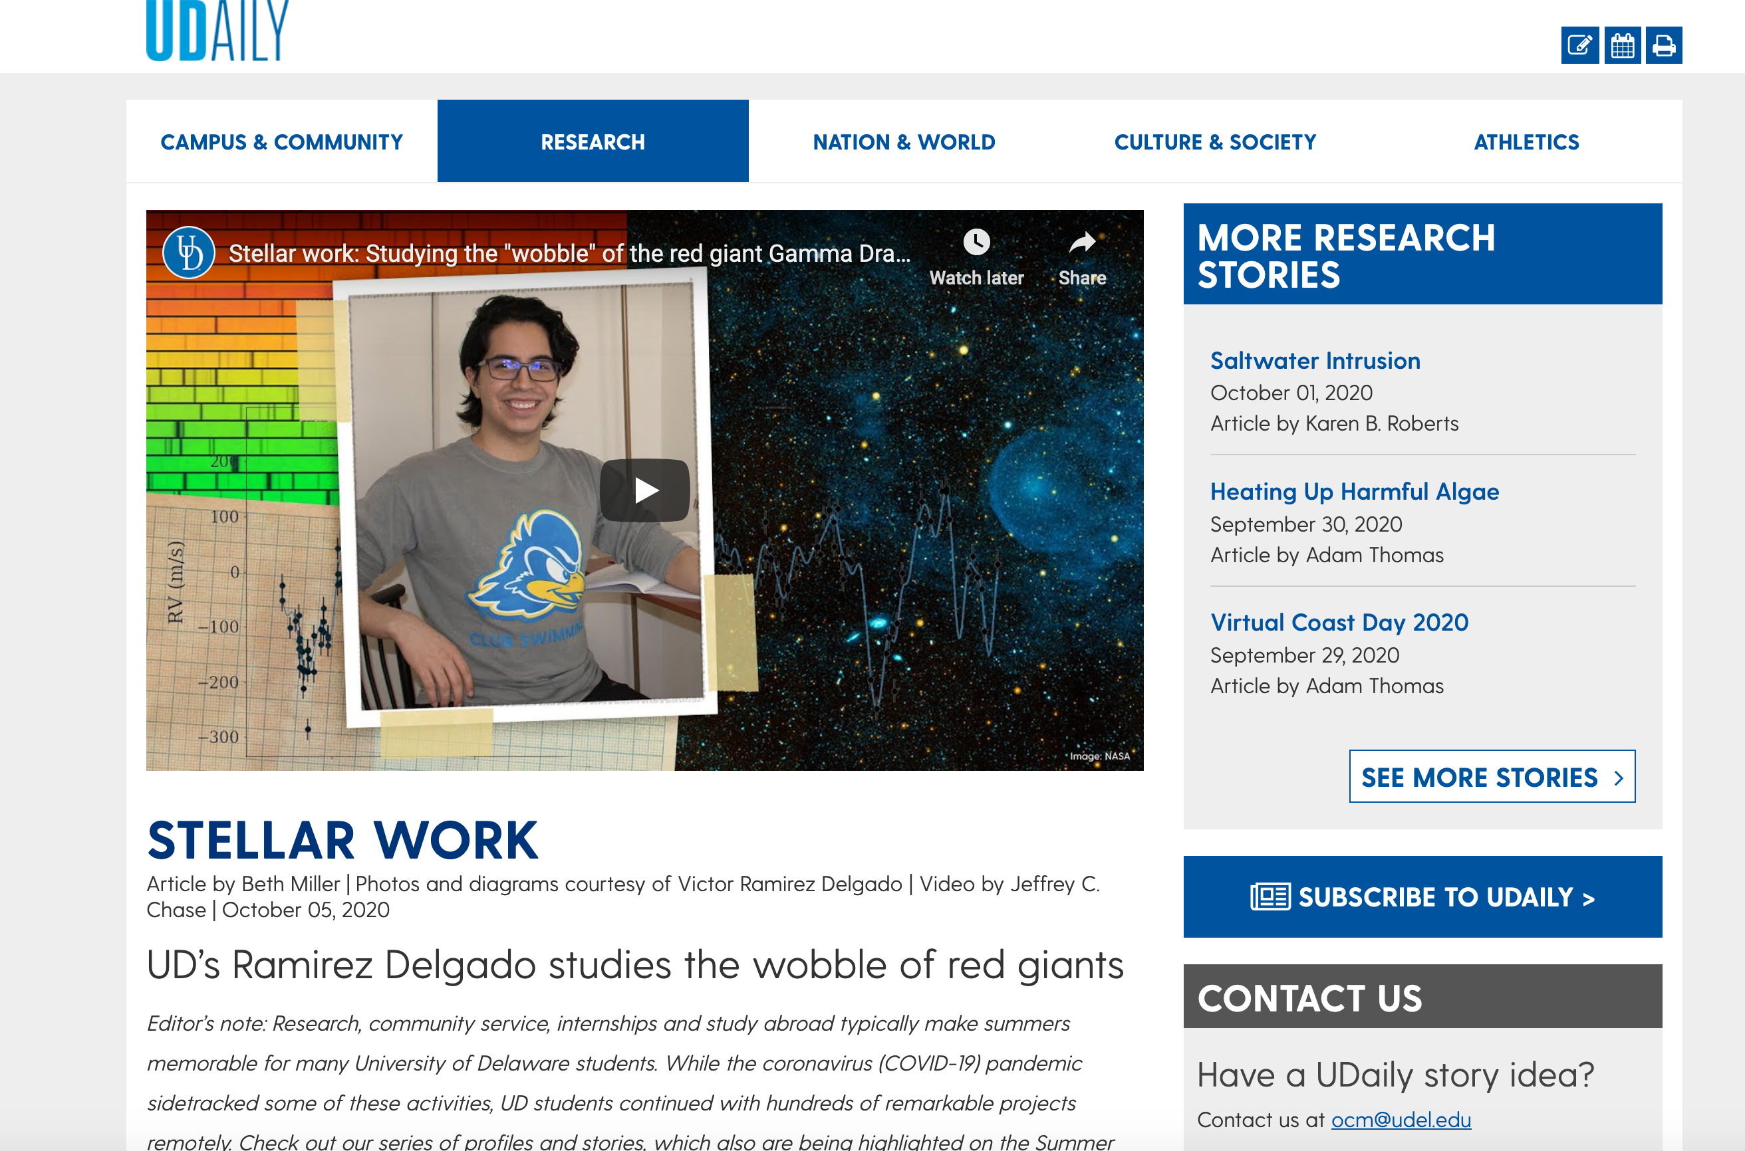

Slide 8
In other words. . .
Why wouldn’t you want to???

Slide 9
How Can You Get Involved?
Our office is a good first stop – we run several programs, coordinate with other research sponsors across campus, and serve as an umbrella for research at UD:
https://www.urp.udel.edu/
On the website you can:
Learn about the programs we run
Make an appointment to talk with one of us to find out more
Ask us anything about research!

Slide 10
URP Programs
UDRAW – for freshmen and sophomores who have work study as part of their financial aid, this is an opportunity to work for a faculty member on a specific project and get an early experience of research. Paid hourly wages
Summer Scholars and Summer Fellows: two major programs supporting several hundred students each summer to work on research projects with faculty mentors. Students receive stipends
Senior Thesis: a year-long capstone project in which students get to work on an individual research topic with a faculty mentor and a committee of readers. Normally leads to conferral of degree with distinction

Slide 11
Other Research Opportunities
Volunteering to work with a faculty member
Independent studies directed by a faculty member
Summer research programs through departments and colleges
Summer interdisciplinary research programs funded by federal grants
Capstone experiences within your major

Slide 12
Summer Application Deadlines
Summer Scholars: Opens January 3rd – Closes March 1st
Summer Fellows: Opens Mid April – Closes two weeks after opening

Slide 13
Bottom Line
At UD
there are many ways you can take part in research with faculty
doing so is incredibly enriching and rewarding, and
having a research experience sets you up well for whatever comes next after UD!

Slide 14
Questions?
Contact info:
Iain Crawford, Faculty Director, icrawf@udel.edu
Lauren Barsky, Associate Director, lbarsky@udel.edu
https://www.urp.udel.edu/

